Slide 1
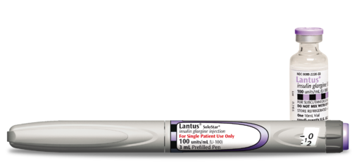
Sanofi-At-A-Glance
By:Juan Galindo

Slide 2
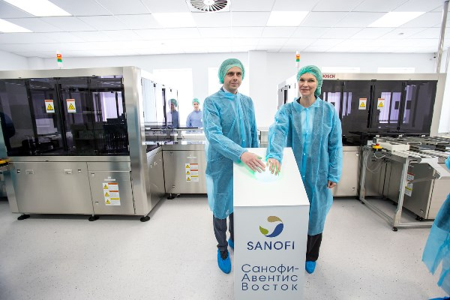
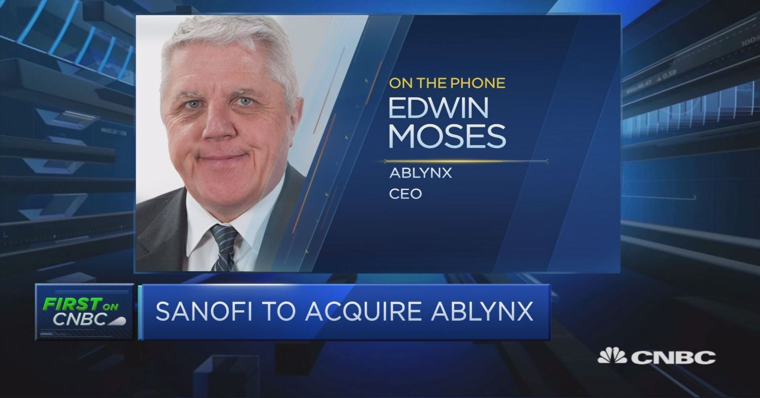
Mission and Future
Sanofi’s mission is to create products to improve the health of anyone with any disease.
Sanofi is also at the cutting edge of drug development through their acquisitions and research.

Slide 3
Needs and Opportunities
Sanofi aims to meet the health needs of patients, whether those needs may be big or small.
Sanofi recognizes and sees growth in any field that can help it achieve its mission.

Slide 4
Sources
-http://www.sanofipasteur.ca/node/40201
-https://labiotech.eu/medical/ablynx-sanofi-acquisition-e3-9b/
-https://gmpnews.net/2018/05/sanofi-will-modernize-its-insulin-production-facility-in-russia/

