Slide 1
Sanofi
Cristian Perez

Slide 2
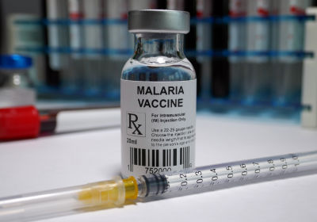
Vaccines at Sanofi
Are a substance to stimulate the production of antibodies and provide immunity against one or several diseases, prepared from the causative agent of a disease, its products, or a synthetic substitute, treated to act as an antigen inducing the disease.
Sanofi is responsible for producing 1 billion doses each year.

Slide 3
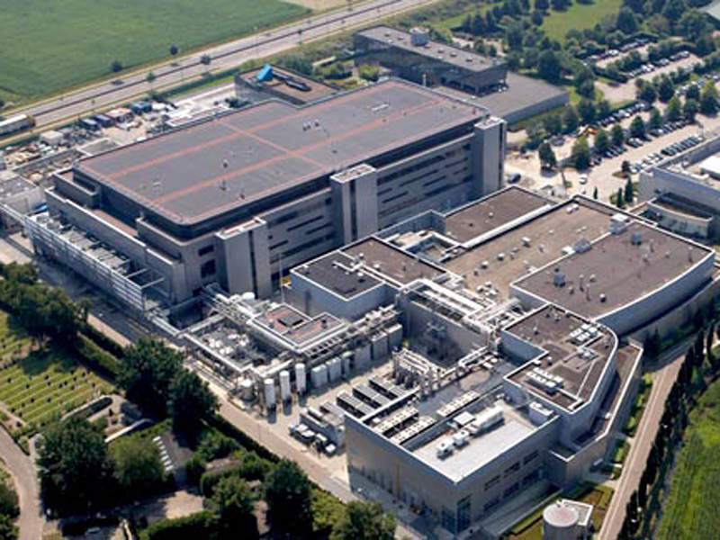
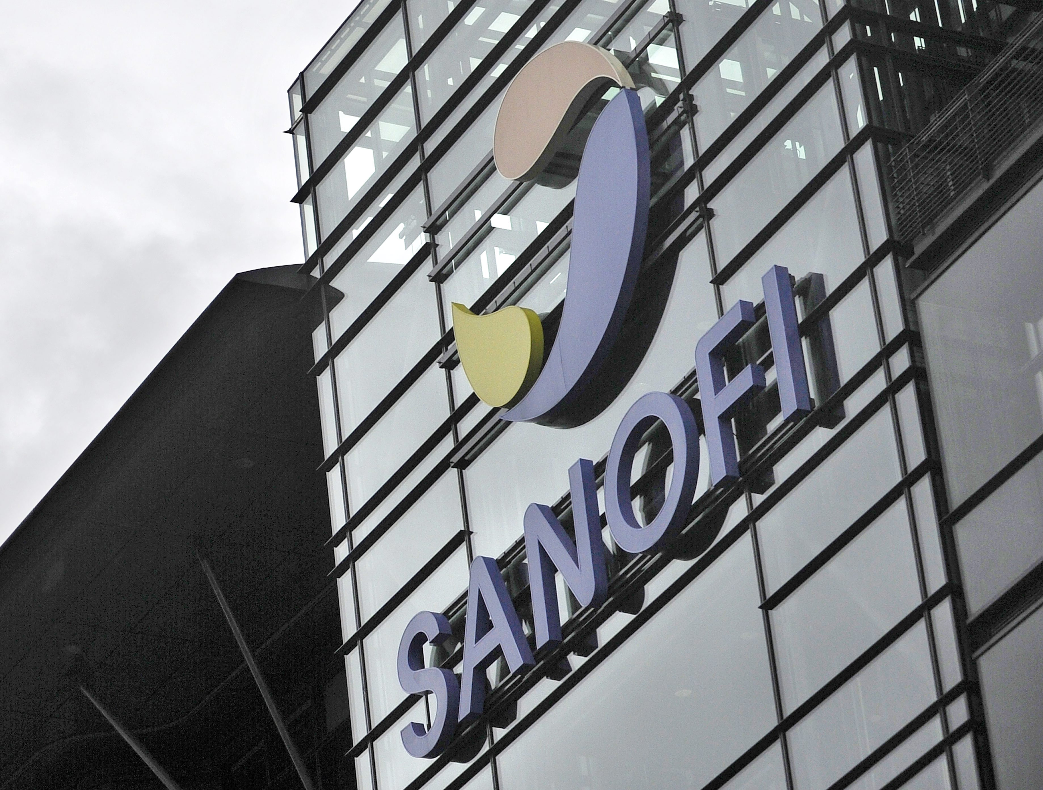
Facility Construction
81 Manufacturing sites in 36 countries.
The investment in construction is increasing dramatically.
The construction of a Facility is a very precise and complex project.

