Slide 1
Sanofi at a Glance
By: Luke Ingenito
Notes:
We designed this template so that each member of the project team has a set of slides with its own theme where he/she can present their research. Members, here’s how you add a new slide to just your set:
Mark where you want to add the slide: Select an existing one in the Thumbnails pane, click the New Slide button, then choose a layout.
The new slide gets the same theme as the previous one you selected.
Careful! Don’t annoy your fellow presenters by accidentally changing their themes. That can happen if you choose a theme Variant from the Design tab, which changes all of the slides in your presentation to that look.

Slide 2
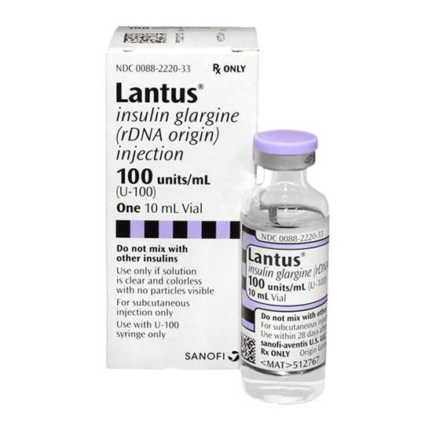
What is Sanofi?
Sanofi is a global pharmaceutical company that focuses on solving global healthcare needs
Areas of research include, but are not limited to, human vaccines, rare diseases, oncology, immunology, and infectious diseases
Popular products developed by Sanofi include Lantus (Insulin for adults and kids with type 1 or type 2 diabetes) , Ketek (used to fight infections caused by bronchitis) , and Allegra (treatment for outdoor and/or indoor allergies)

Slide 3
Career Opportunities at Sanofi
At Sanofi, employees can work in a wide variety of fields
Research and Development – allows employees to work on the development of pharmaceutical drugs and treatments
Manufacturing – allows employees to produce Sanofi products for distribution
Sales and Marketing – allows employees to sell and advertise the products developed by Sanofi
Personally, I am most interested in the manufacturing area because of its focus on the development of efficient industrial performance, production, and testing processes

