Slide 1
Sanofi At-A-Glance
By Hien Ngo

Slide 2
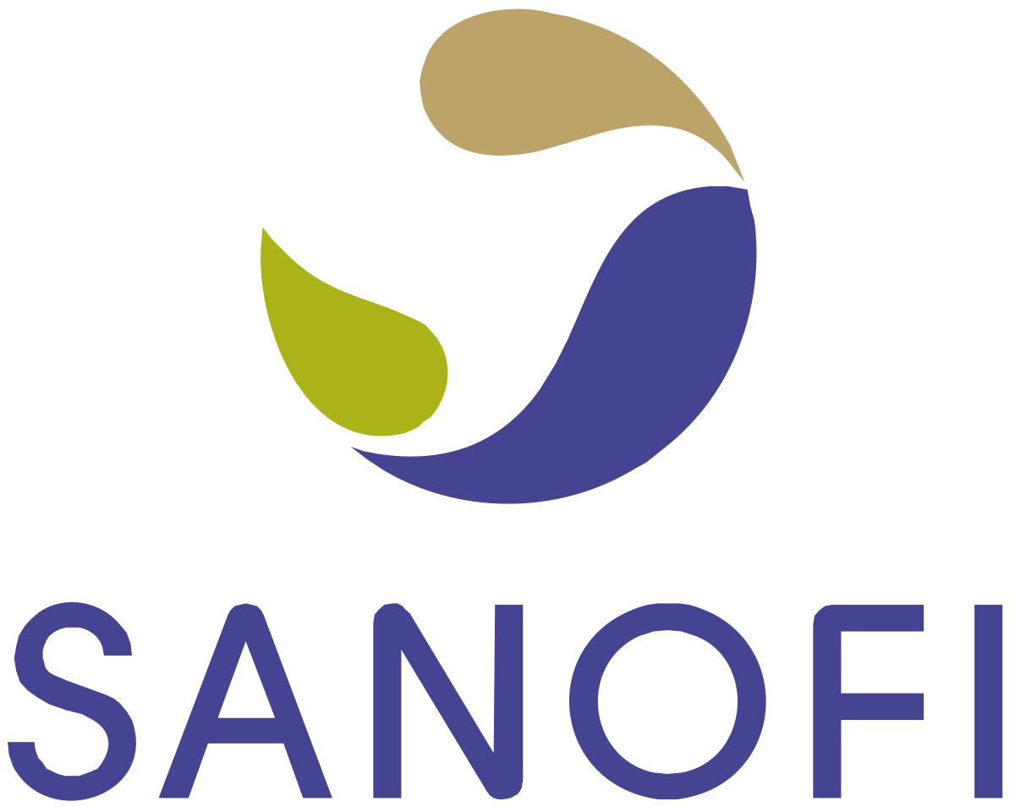
Sanofi
Is a global biopharmaceutical organization, which commits to improving people’s lives around the world.
Provides medicines and healthcare solutions in more than 170 countries.
Has 79 programs to access healthcare in 79 countries.
Notes:
1/ Sanofi is a global biopharmaceutical organization for healthcare that it commits to improving people’s lives worldwide. It has more than 100,000 employees and presents in 100 countries. However, Sanofi provides medicines and healthcare solutions in more than 170 countries.
2/ Sanofi has 79 programs to access healthcare in 79 countries.

Slide 3
Focus & Responsibility
Focus | Responsibility
Oncology Immunology and inflammation Rare blood disorders Rare and neurologic diseases Diabetes and cardiovascular (DCV) Therapeutic fields are the most urgent for patients. | Improve access to healthcare and high-quality medications for underserved populations and women. Committed to equality and inclusiveness, community development, medical ethics and transparency, and "Planet Mobilization”
Notes:
Besides maintaining the commitments to vaccines, Sanofi also focuses on five research areas, which are oncology, immunology and inflammation, rare blood disorders, rare and neurologic diseases, diabetes and cardiovascular (DCV)
Specially, they focus on therapeutic fields, which are the most urgent for patients’ needs.
2/ Their responsibilities are to improve access…. "Planet Mobilization,” which is a policy that limits direct and indirect impacts of their operations on the environment.
They reduce greenhouse gas emissions, reduce waste and water consumption. For example, in 2018, their water consumption decreased by 14% compared to 2015.

