Slide 1
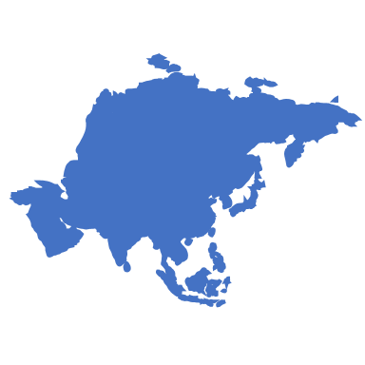
sanofi at a global glance
Anne joseph

Slide 2
What is Sanofi?
Sanofi is a multinational pharmaceutical company.
The U.S. Headquarters are located in Bridgewater, New Jersey.
Sanofi currently has…
14,000+ worker in the U.S. workforce
100,000+ worker in the global workforce
Assisted in100+ countries

Slide 3
What does Sanofi do?
Sanofi’s Mission:
Sanofi supports people through their health challenges by preventing illness with vaccines and providing innovative treatments to fight pain and ease suffering. Sanofi also works towards making treatments accessible and affordable for everyone.
Sanofi’s purpose:
“To understand and solve healthcare needs of people around the world”
Who is involved in their mission and fulfilling their purpose?
Teams:
Research & development
Manufacturing
Marketing
Medical
Market access
Students, Graduates and Young Professional ← THAT’S US!

Slide 4
What are Sanofi’s products?
Vaccines:
Yellow Fever Vaccine: Given to people who are at increased risk for yellow fever to help prevent them from getting the disease.
Consumer Products
Chattem: A Sanofi company that produces products that we all know and use in our day to day lives:
ICY HOT
Gold Bond
Allegra
Cortizone-10
Prescription products
Ambien: Short term insomnia
Plavix: Acute Coronary Syndrome
Lantus: Diabetes
These are only a few of the more common products Sanofi produces and innovates.

