Slide 1
Sanofi
Le Sanofi d’aujourd’hui repose sur l’héritage de transformer l’impossible en possible pour les personnes et les communautés du monde entier.

Slide 2
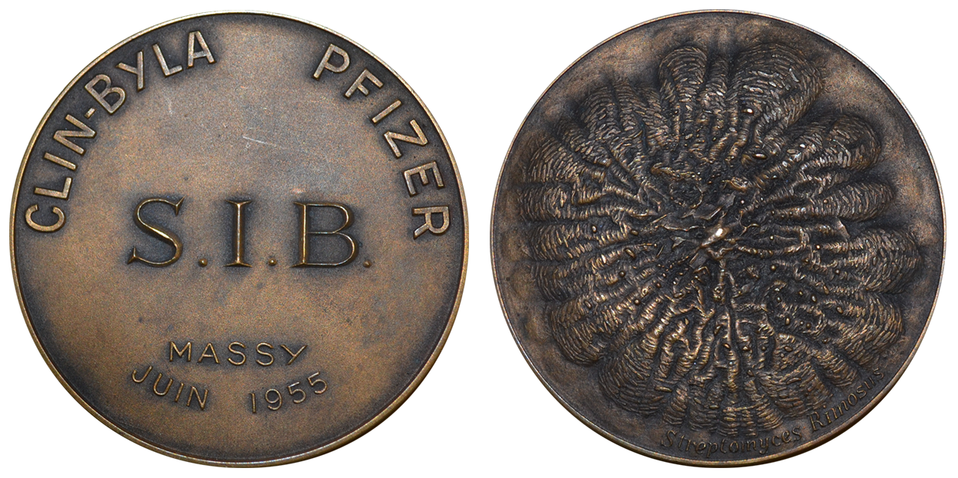
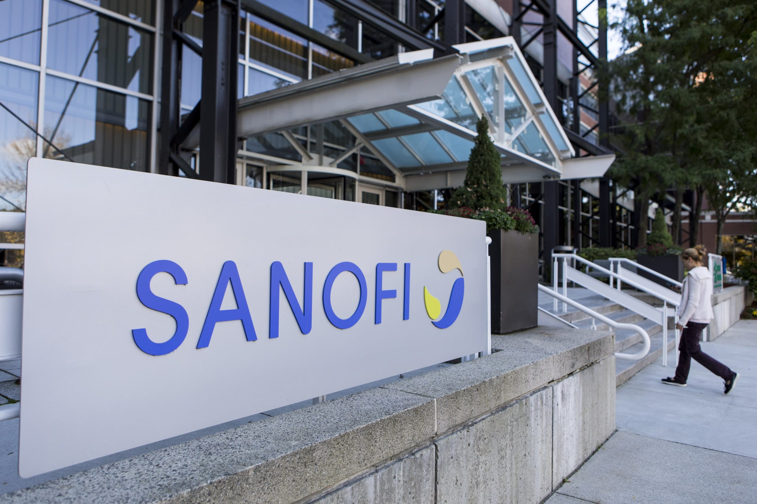
Swift History:
Sanofi Ancestors
Curious fact: Sanofi is a subsidiary company of French firm named Elf Aquitaine.

Slide 3
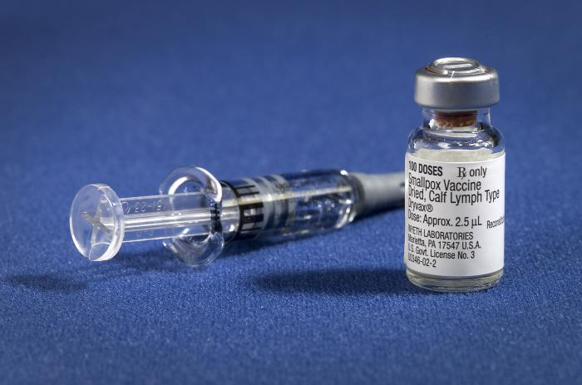
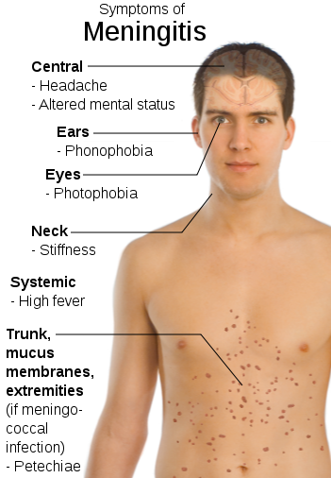
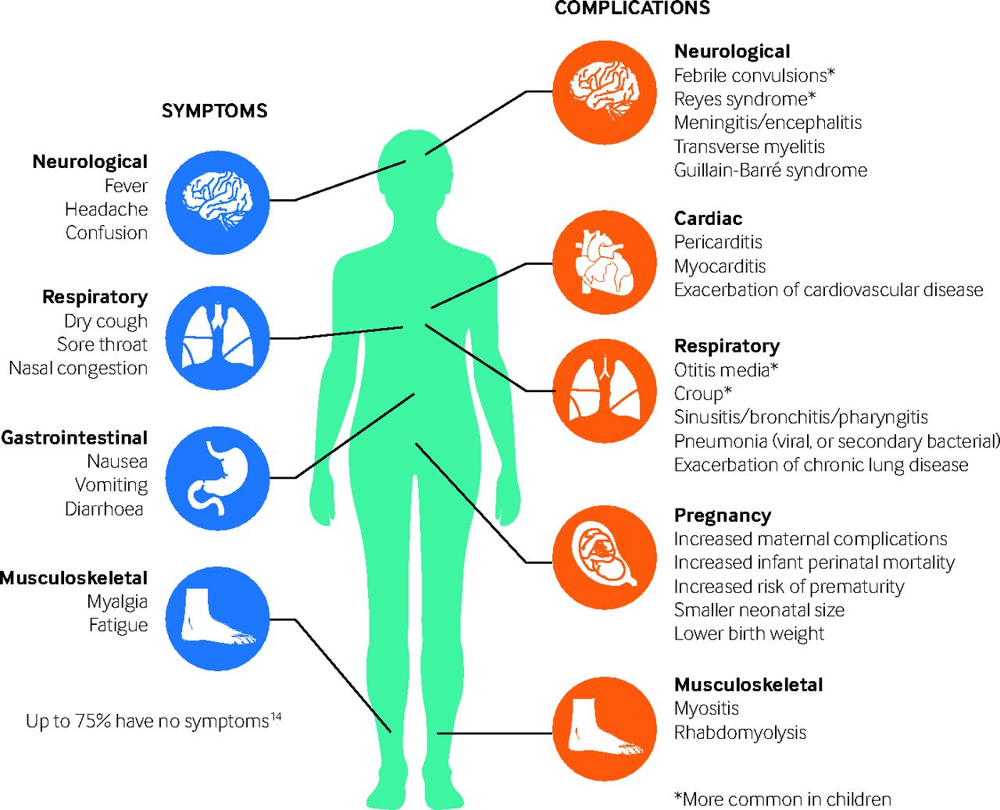
What is Sanofi known for?
This Photo by Unknown Author is licensed under CC BY
This Photo by Unknown Author is licensed under CC BY-SA
This Photo by Unknown Author is licensed under CC BY-SA
This Photo by Unknown Author is licensed under CC BY-NC
This Photo by Unknown Author is licensed under CC BY-NC

Slide 4
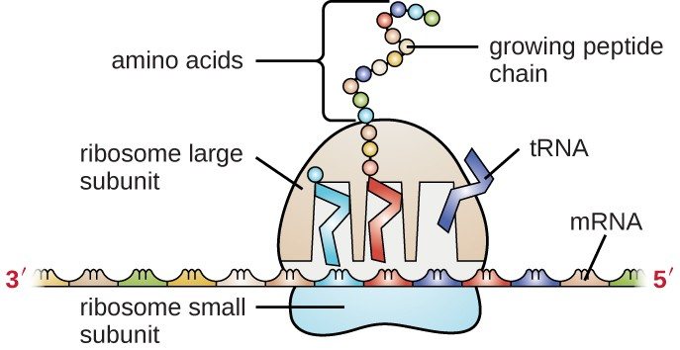
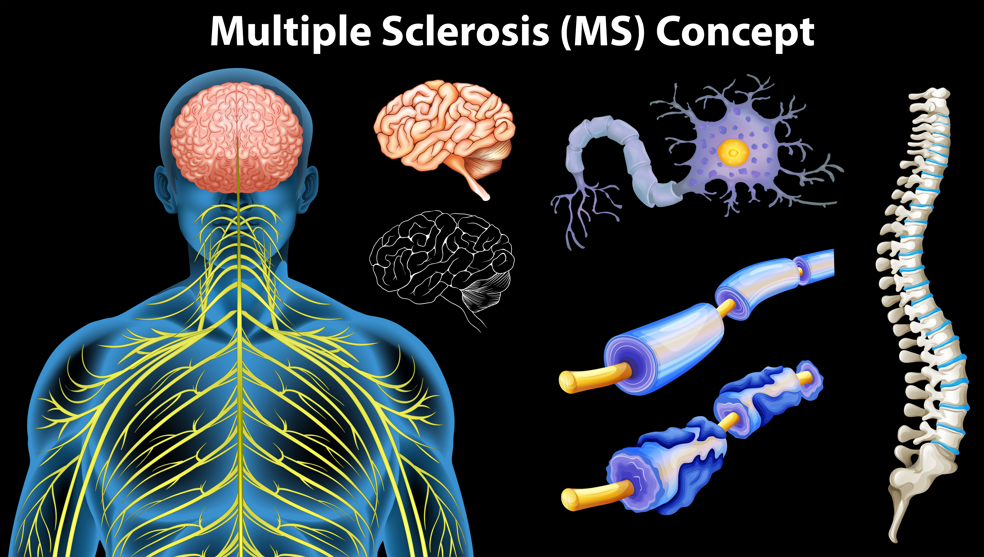
mRNA Research at Sanofi.
This Photo by Unknown Author is licensed under CC BY
mRNA research and applications contribute to help neurodegenerative disorders such as multiple sclerosis, which if I were to oversimplify it, it is a neurodegenerative disease in which the immune system mistakenly attacks the nervous system

Slide 5
Thank you for paying attention.
Let’s Connect on LinkedIn: Juan David Diaz

