Slide 1
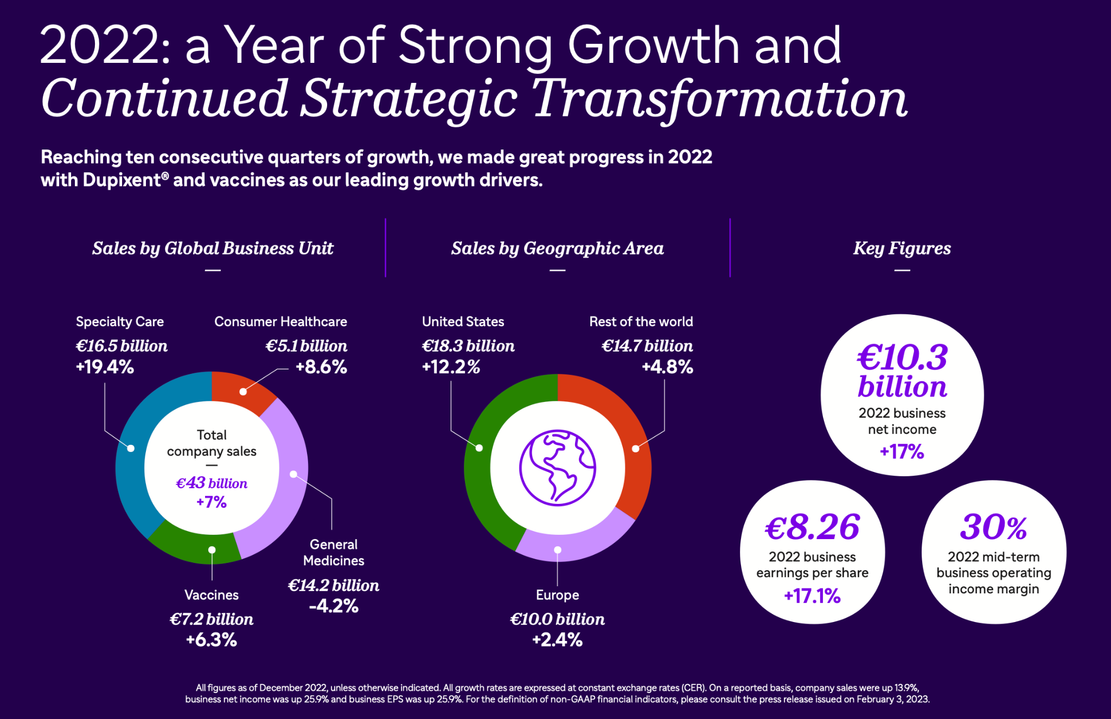
A Presentation by Zachary Cole
A Glance at Sanofi: A Global Pharmaceutical Giant
Exploring the Play to Win Strategy
Information found from Sanofi’s 2022 Annual Report
& Sanofi’s Q1 & Q2 2023 Fiscal Report

Slide 2
Focusing on Growth
Researching and Developing the future of Pharmaceuticals

Slide 3
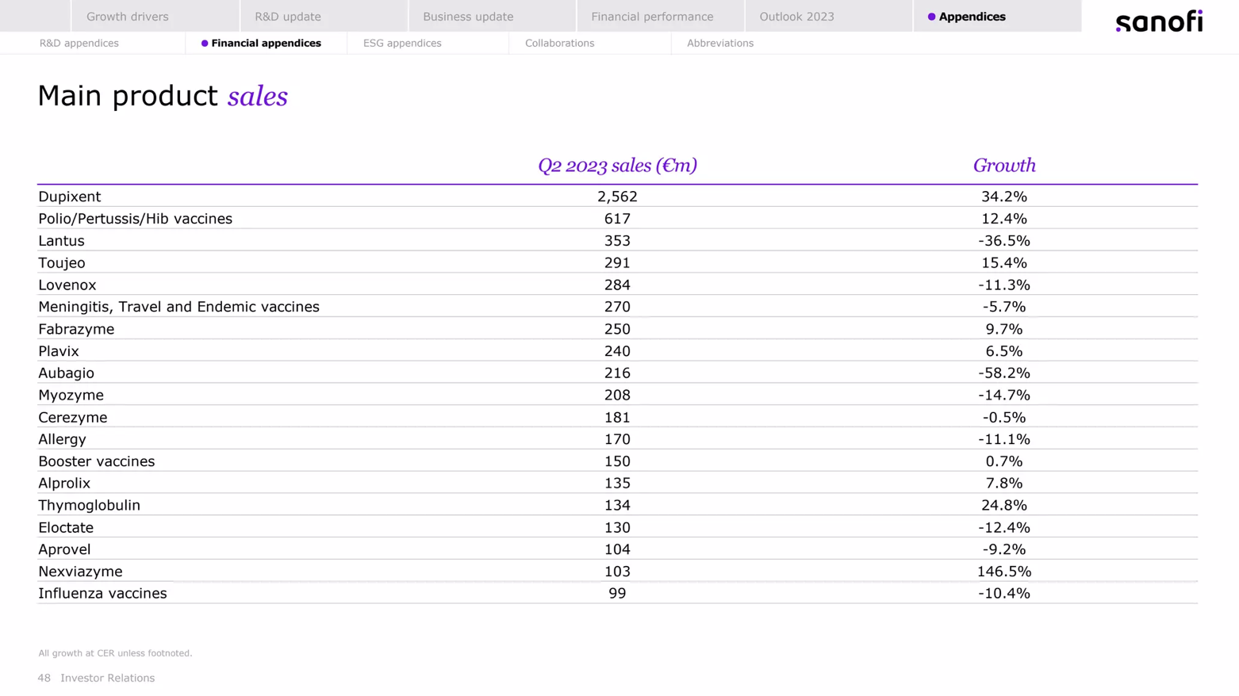
Leveraging innovation to drive growth
Blockbuster Drugs are ones that surpass $1 Billion in sale. They have a huge impact in the success of the company

