Slide 1
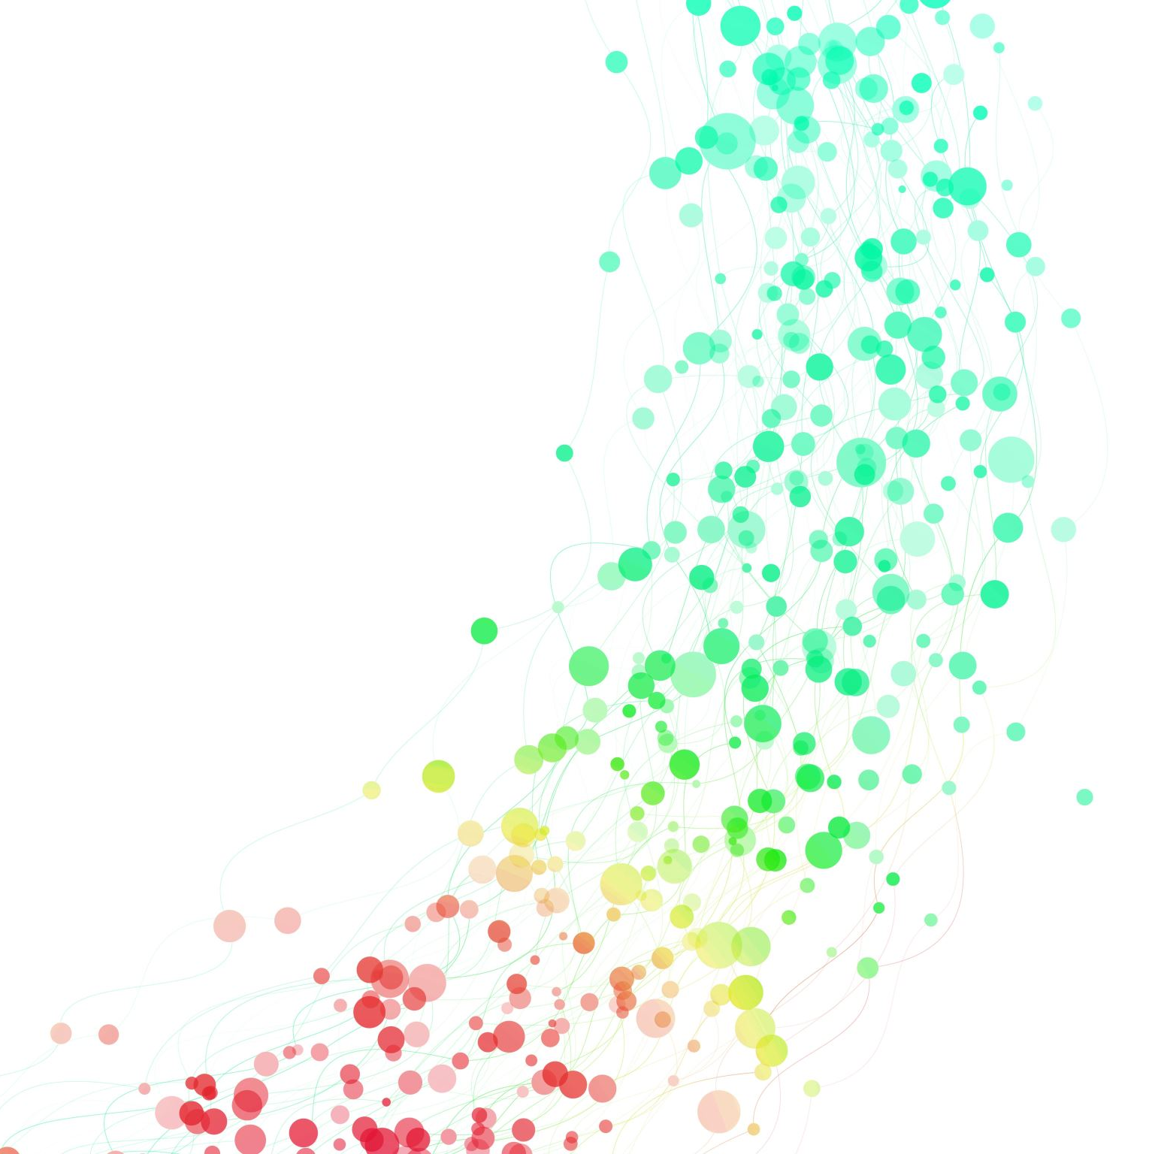
SANOFI AT A GLANCE
Abdelrahman Ahmed

Slide 2
Introduction to Sanofi
Sanofi is a global healthcare leader, headquartered in Paris, France.
It specializes in pharmaceuticals, vaccines, and consumer healthcare products.
Operates in over 100 countries with a diverse portfolio addressing various therapeutic areas.

Slide 3
Sanofi's Purpose and Mission
' Empowering Life' - Sanofi aims to improve access to healthcare and enhance the quality of life for people worldwide.
Focused on addressing global health challenges and providing sustainable healthcare solutions.
Enhanced environmentally friendly practices ​including water/waste stewardship​, carbon neutrality, and usage of renewable energy.

Slide 4
Innovations and Achievements
Digital Health Initiatives:
Investments in digital health platforms and AI companies including OpenAI and Formation Bio to enhance patient care and drug development.
Accelerating groundbreaking research improving the efficiency of identifying potential drug targets by 20-30%​.
Pharmaceutical Innovations:
Development of breakthrough treatments in diabetes, oncology, and rare diseases.
Pioneering research in immunology and cardiovascular health.
Vaccine Contributions:
Sanofi Pasteur, a world leader in vaccine production, has developed vaccines for influenza, dengue, and COVID-19.

