Slide 1
at a glance
By Cynthia Enriquez

Slide 2
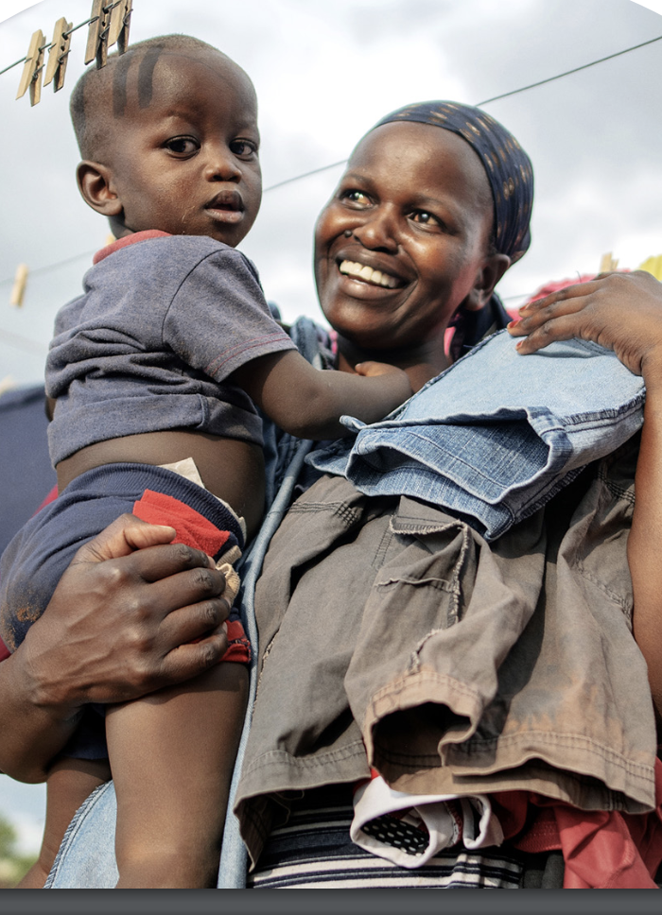
Sanofi’s mission and foundations
Mission: To improve people's lives by discovering, developing, and delivering medicines and vaccines, and by building a healthier world.
Sanofis’ Pillars for Social Impact:
Sanofi Global Health Unit
Corporate Social Responsibility
Foundation S – The Sanofi Collective

Slide 3
Why is their work different?
A Million Conversations
A Million Conversations is Sanofi’s global initiative to rebuild trust in healthcare with the underrepresented. Specifically with Black and ethnic minority groups, women, people with disabilities, and LGBTQ+ communities.
Sanofi NextGen Scholarship
Inclusive Dialogues
Influence the System

Slide 4
Thank you!!

