Slide 1
Sanofi at a Glance
Emily Rambo

Slide 2
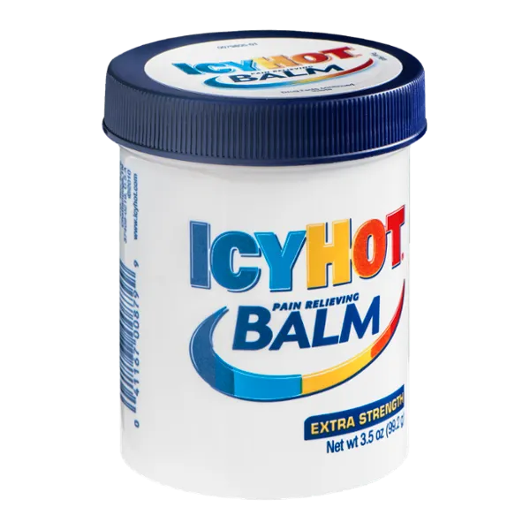
What is Sanofi?
A global health care company
Their goal is to help people through medicine:
For example :
Insulin
Polio, Rabies, Influenza vaccines
OTC drugs: Allegra and Icy Hot
Notes:
What is the industry and their purpose?
It is a global healthcare company that uses science to help people.
In order to due this, they discover, develop, and deliver medications and vaccines
What products/services do they offer?
In the US, they produce medications such as insulin. They produce vaccines tetanus (deadly bacteria), rabies, Polio, and influenza. They produce OTC medication such as allegra, icyhot, and more!
Implies who their patients are….diabetes, people in school, health care, people with allergies…pain..etc
What career opportunities are available at Sanofi? Which one interests you?
A lot of research positions are available. The most interesting I found was a job opening in canada where they’re looking for a scientist researching in vaccines. Other positions involve research in medical development, chemistry, and immunology/inflammation.
What has sanofi been on the news for recently?
Who are their healthcare providers?
Sanofi collaborates with health insurance company,“Horizon Health,” to make doctor/dental appointments in the insurance company’s network. They also help with handling claim/billing questions and providing a 24/7 nurse line.

Slide 3
Careers & Initiatives:
Many R & D Positions
Medical Development, Chemistry, Immunology, Inflammation, Vaccines
Initiatives:
Providing products at no cost for uninsured patients
Partnering with charities for disaster relief

