Slide 1

Sanofi: Driving Innovation In The Gulf Region
By Dan Heredia

Slide 2

What Does Sanofi Do And Values
Values:
Sustainability
Righteous Ethics
Avoiding Corruption
Civic Engagement
Mission Statement:
“"To improve people's lives by pursuing scientific breakthroughs and providing healthcare solutions that address unmet medical needs."

Slide 3
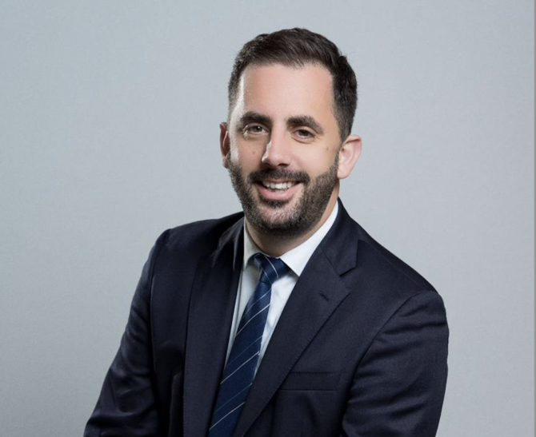
Baptiste de Clarens And Vaccines
His Initiative
Vaccine Antibodies
RSV Monoclonal Antibody in Kuwait
Reduced Infant Hospitalizations
General Manager for Vaccines
Worked For Sanofi for 18 years
Worldwide Career Experience
Challenges:
Adult Immunization Rates

