Slide 1

Sanofi At-A-Glance
By: Esmeralda Ochoa

Slide 2
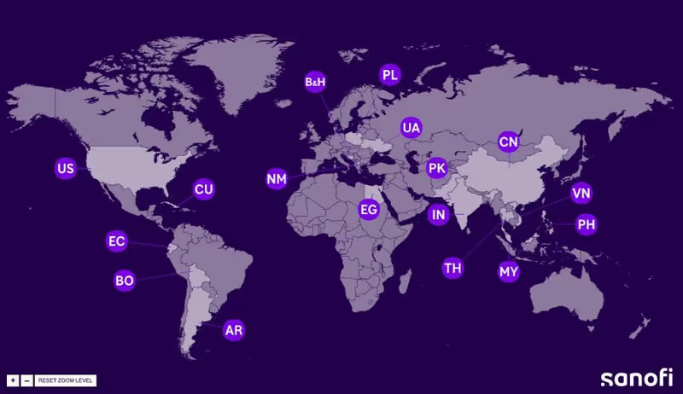
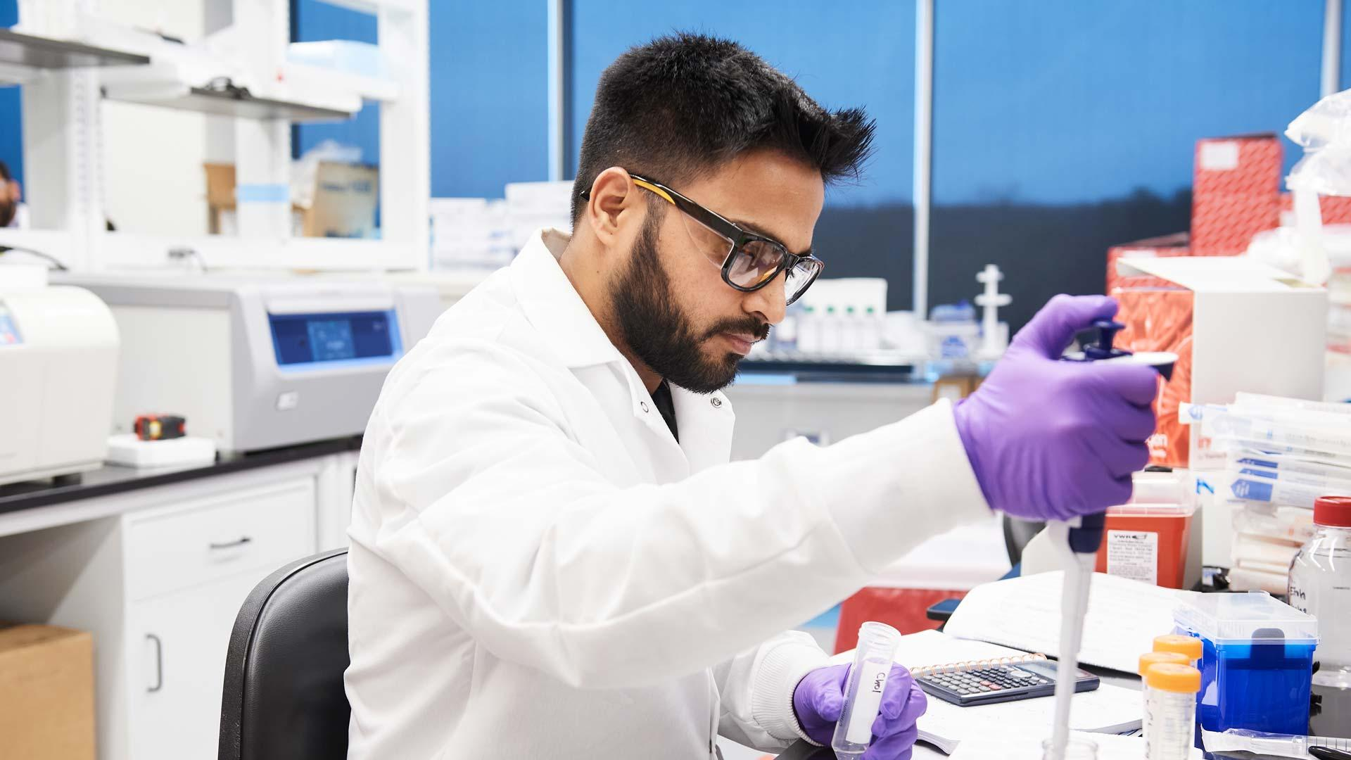
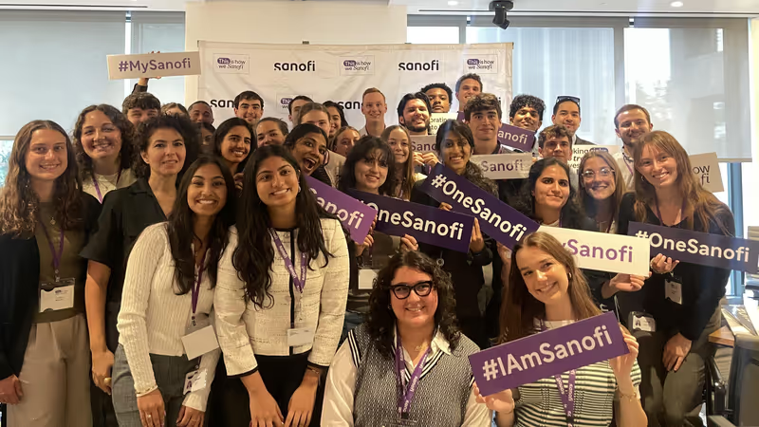
Who they are
What they do
Mission Statement
Global pharmaceutical company that operates in over 100 countries
Discover, develop, and deliver medicines and vaccines that help millions of people worldwide
“We chase the miracles of science to improve people's lives"

Slide 3
What Sanofi has done recently in 2025…
New Medicine for Bleeding Disorders
In March 2025 the U.S. approved a new Sanofi treatment that only needs to be taken every two months which will make life much easier for patients.
Buying Other Companies to Grow
In June 2025, Sanofi bought two smaller companies to develop new medicines for rare diseases and Alzheimer’s. This helps them bring more treatments to patients faster.
Making Big Investments
Sanofi annocused in May 2025 that they will spend $20 billion in the U.S. to improve research and make more medicines.

