Slide 1

A Look into Sanofi
Sebastian Portillo

Slide 2


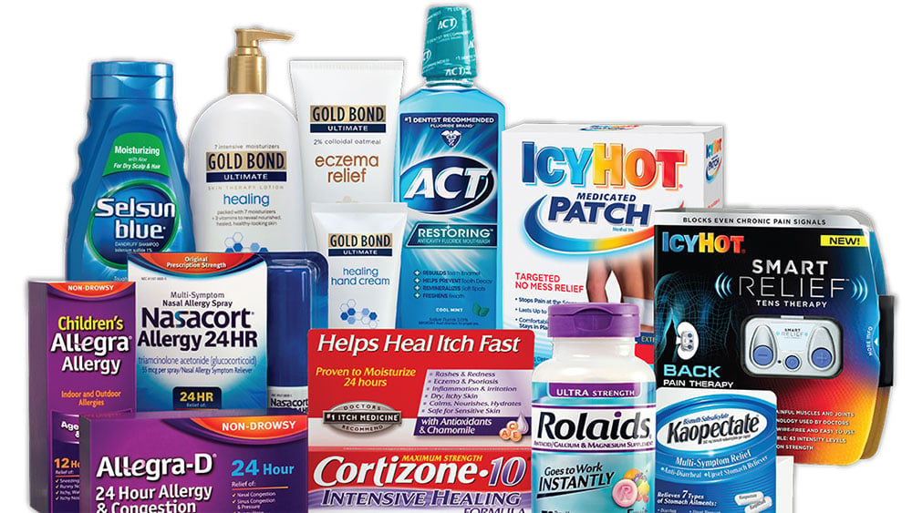

About Sanofi
MONTH YEAR
Sanofi is a Multinational Pharmaceutical company that has expanded across the globe, leading in technical and medicinal practices and development. Some of its know products are Cortisone, Allegra and IcyHot. Sanofi is currently the biggest vaccine manufacturer, providing around half a million vaccines to people around the globe a year.

Slide 3
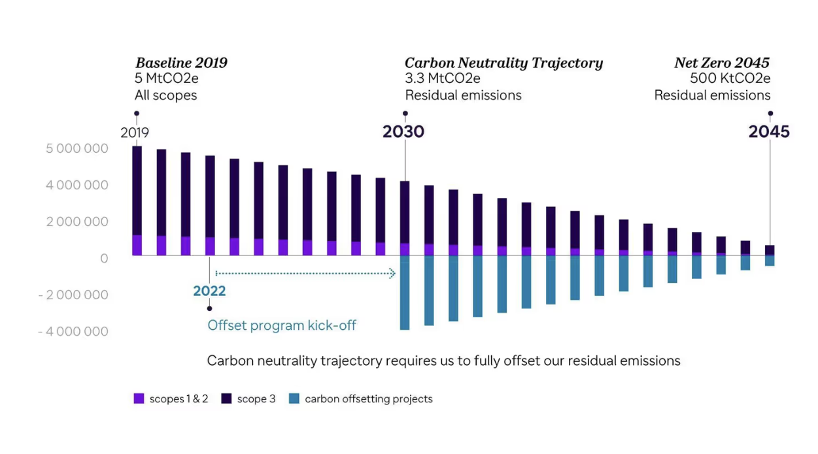


Environmental Practices
Apart from exceeding in technological advances, medical and health miracle like discoveries, Sanofi also is one of those companies that cares about their environment. Sanofi has put a lot of effort in some major points to help reduce their environmental impact.
Sanofi has come up with a on-going plan to reduce their greenhouse gas emission significantly. They aim to become carbon neutral by 2045, having already reduced emission significantly.
Sanofi has also aimed to become a company that practices reducing operational waste, incrementing recycling/reuse and recovery of products that harm the environment, achieving this in 2025.
Sanofi has also started to think of ways in which they can make their products more bio-friendly, using resources more efficiently, by doing this they promote reducing the use of their products.

Slide 4
Thank
you

