Slide 1
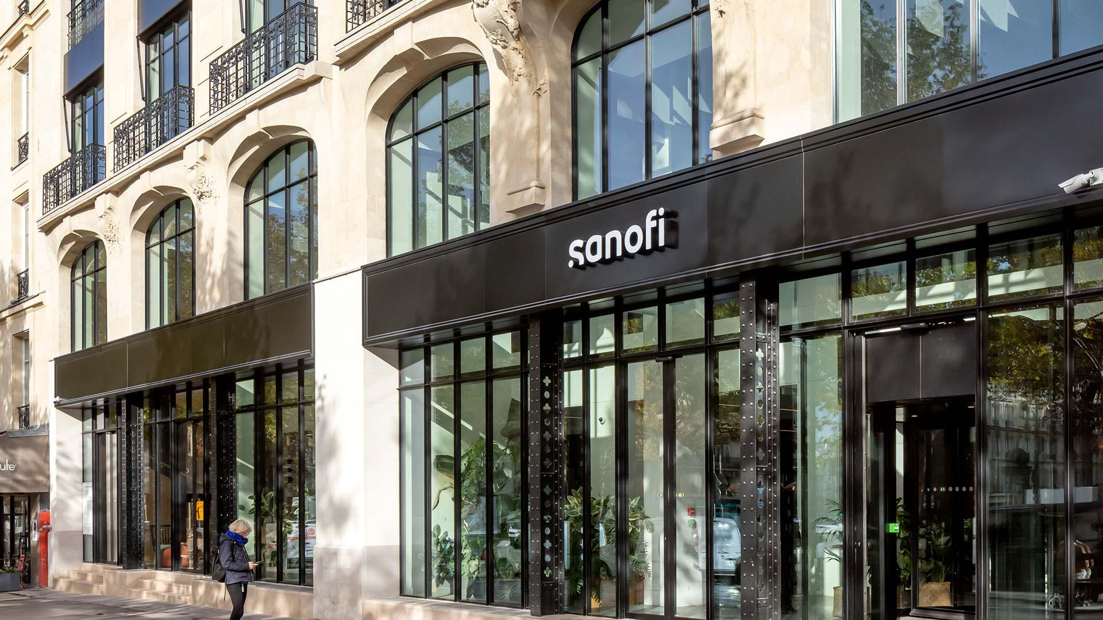
SANOFI AT A GLANCE
Harrison Gale
ThePhoto by PhotoAuthor is licensed under CCYYSA.

Slide 2
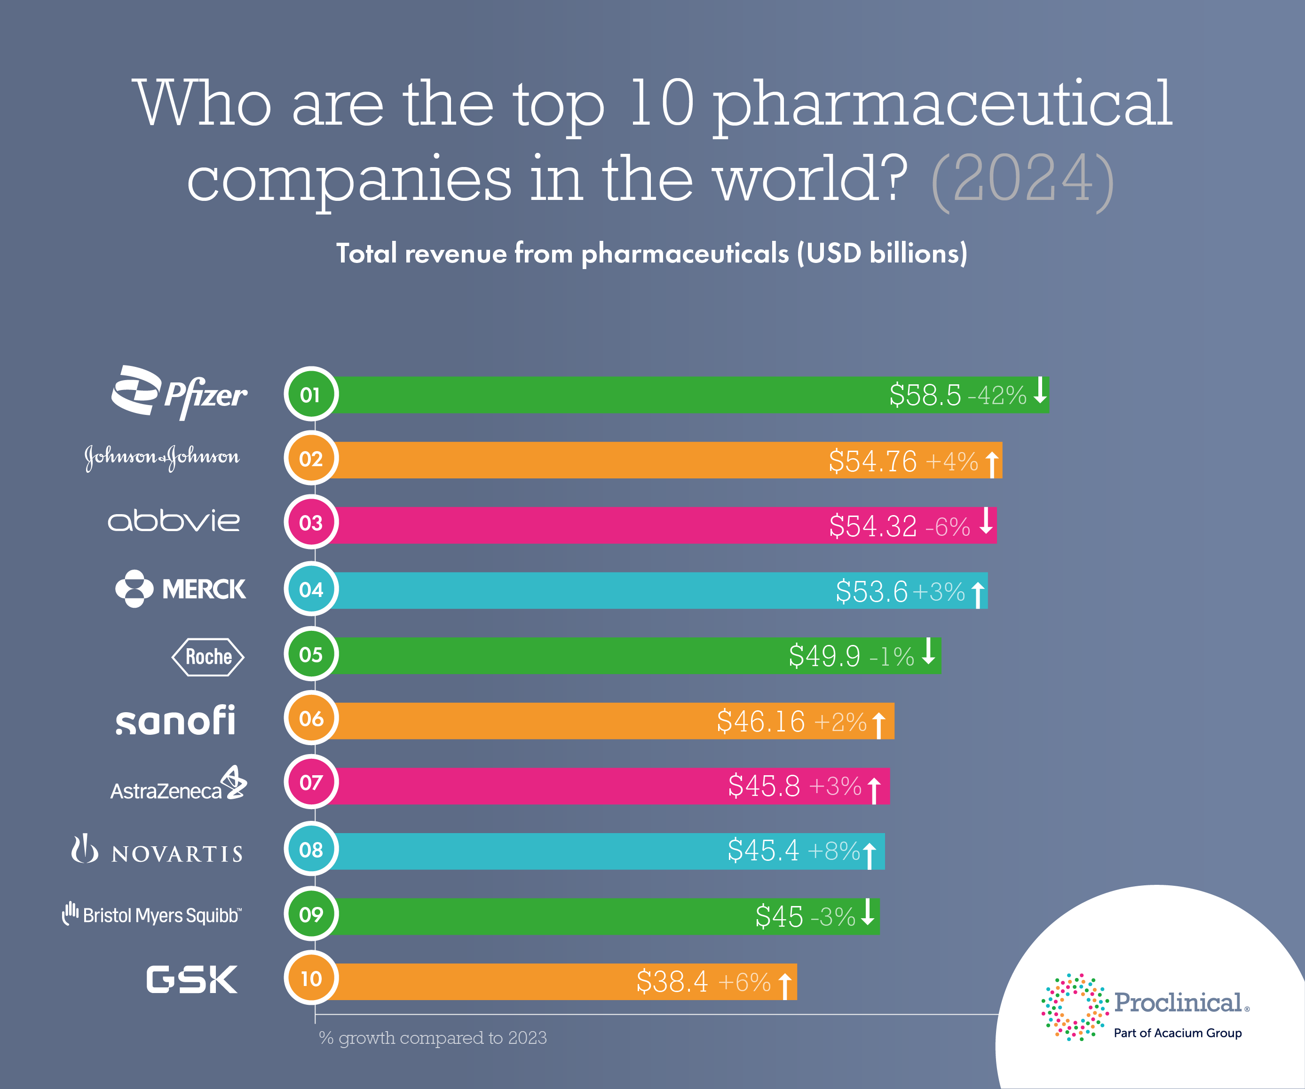
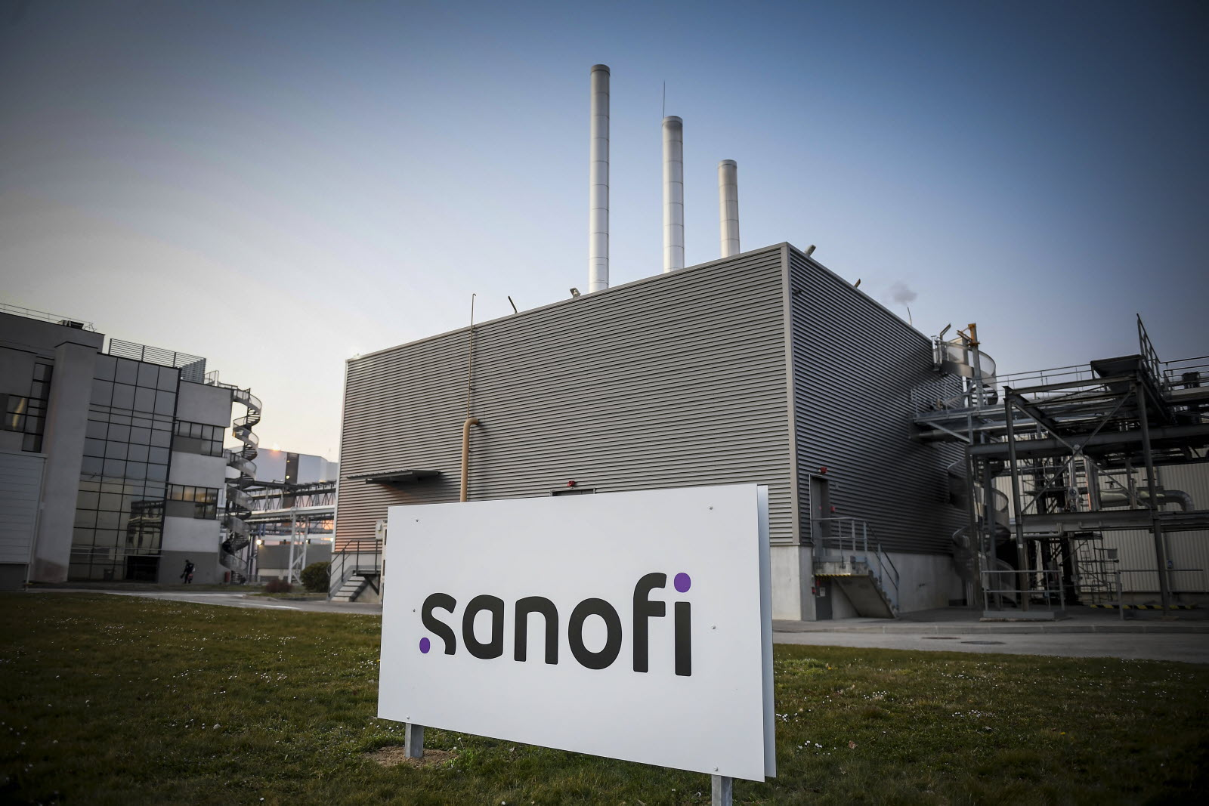
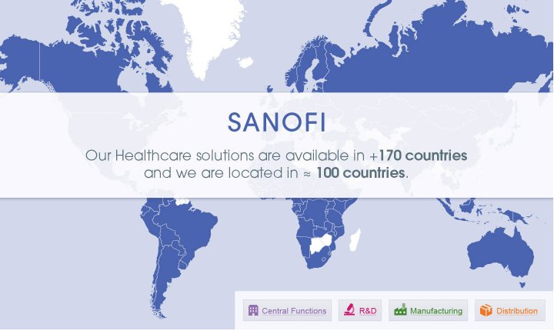
What is Sanofi
Sanofi which was founded in 1973 with its headquarters in Paris, France is a leading biopharmaceutical company that operates in over 70 countries with over 83,000 employees. This company is widely known and celebrated for its major breakthroughs in vaccines and treatments such as polio, meningitis, Lantus for diabetes, and its blockbuster drug Dupixent. In this past year Sanofi brought in around $48 billion in revenue and the company only plans to keep investing in research and development with a current focus on immunology, specialty care, and vaccines. With the company's "Play to win" strategy in mind Sanofi continues to advance medical treatments worldwide while also holding true to their commitments in sustainability and public health.

Slide 3
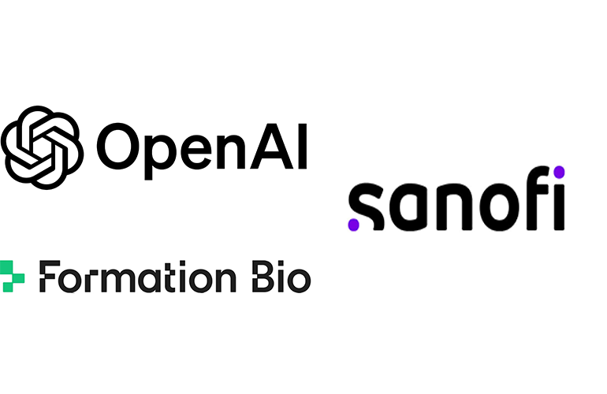
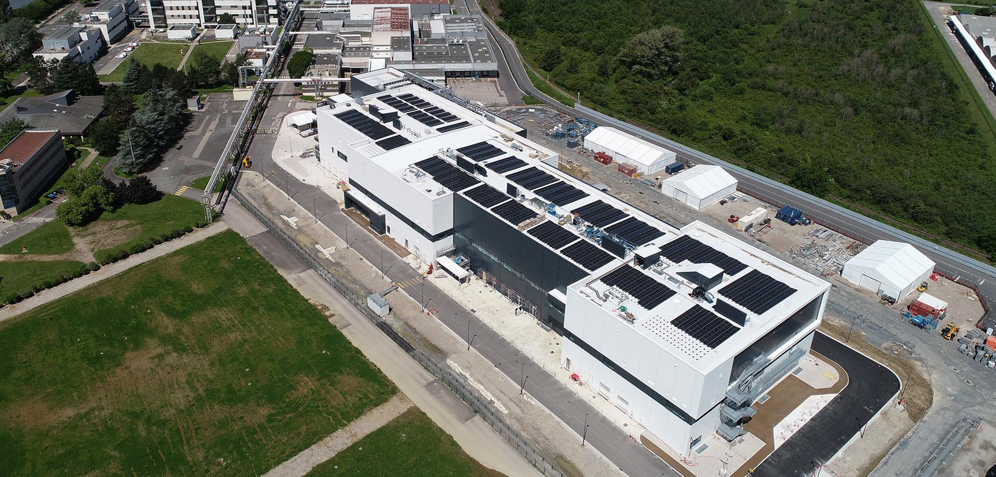
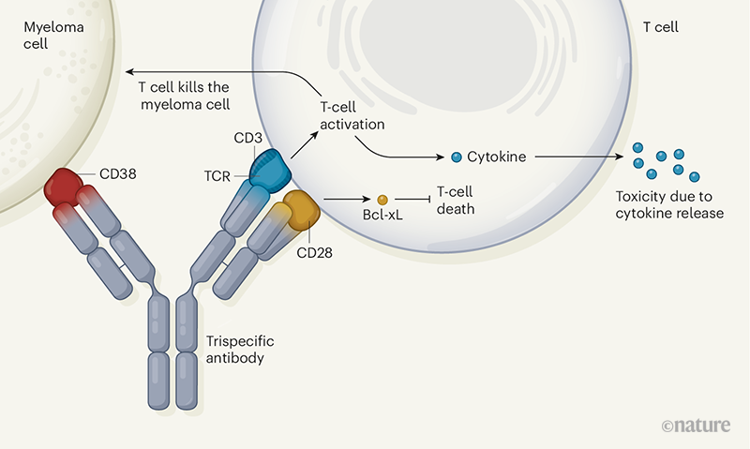
Next Generation AI Collaborations: Sanofi has created partnerships with AI companies such as OpenAI in order to discover new drugs faster and smarter
Modular Factory ("Lego Plant"): Sanofi is making reconfigurable production lines that can quickly switch between producing several different vaccines and biologics in order to respond to emergencies like a pandemic
Sanofi's Role in Biomedical Advancements
AI Designed Trispecific Antibodies: Sanofi is working on the first ever pharmaceuticals that are engineered to hit three disease targets at the same time

