Slide 1


“Conducting business with honesty and integrity and creating an inclusive environment where people feel empowered and safe to speak up.”
Sanofi At A Glace
Theresa Jimenez-Garcia

Slide 2

Who Is Sanofi ?
Sanofi is a global healthcare company that specializes in research, development, manufacturing and marketing of pharmaceutical products vaccines and consumer healthcare products. Sanofi has been in business for 51 years and counting all over the world. Trying to help build medicine and vaccines to help people combat certain diseases.

Slide 3
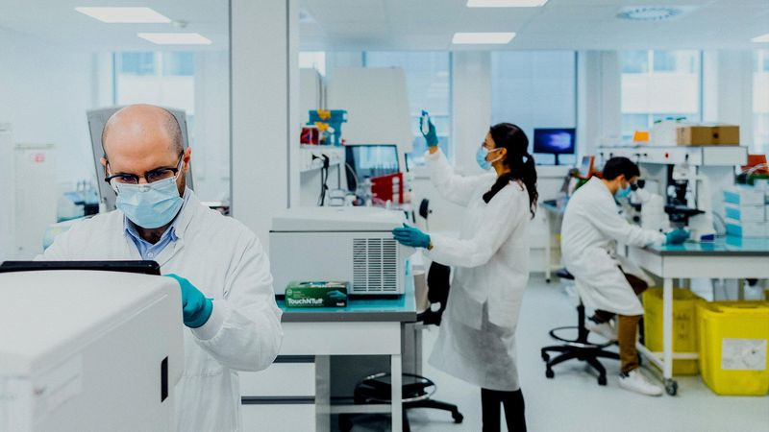
Sanofi Treats
“Chase the miracles of science to improve people’s Live’s”
Immunology & Inflammation
Oncology
Rare Diseases
Treatment for atopic dermatitis asthma and chronic rhinosinutis with nasal polyps. There is also treatments for dermatological, respiratory and gastrointestinal diseases
Various cancers including skin, prostate , lung , colon,
Breast and blood cancers
.
Rare and difficult to treat sometimes can be misdiagnosed .Largest in the industry with approved treatments for conditions like fabry disease, Gaucher disease and pompe disease

Slide 4

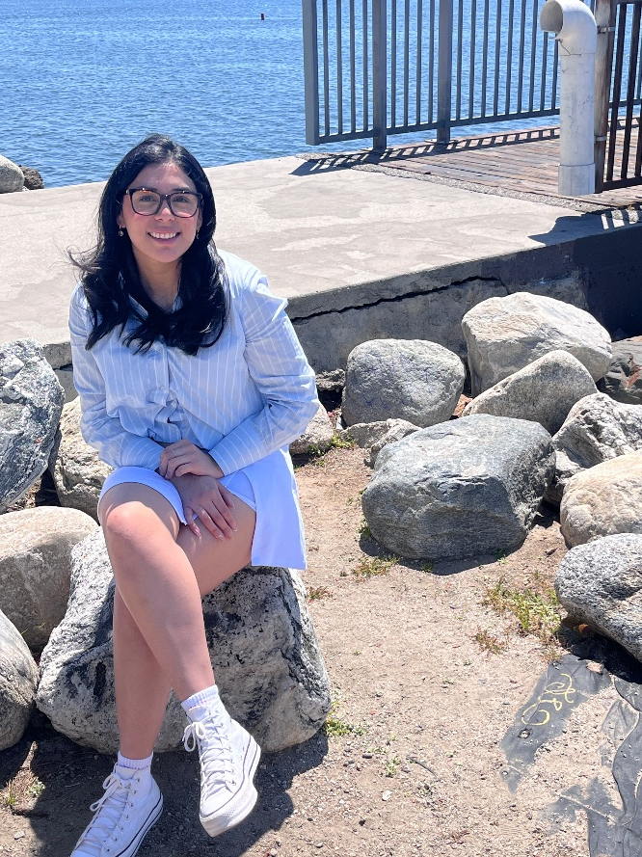
Theresa Jimenez-Garcia
Thank you so much for listening! I can’t wait to learn so much more about Sanofi. See you soon !

