Slide 1
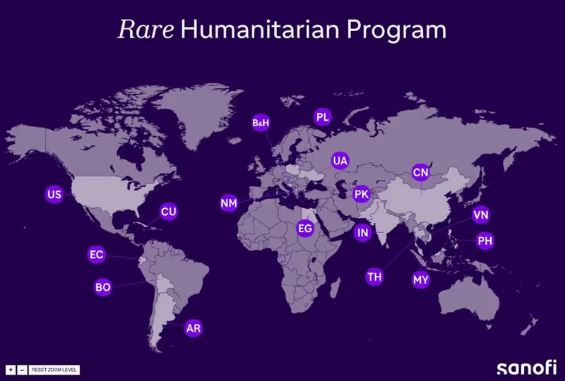

Sanofi at a Glance
Maryam Elsayed

Slide 2
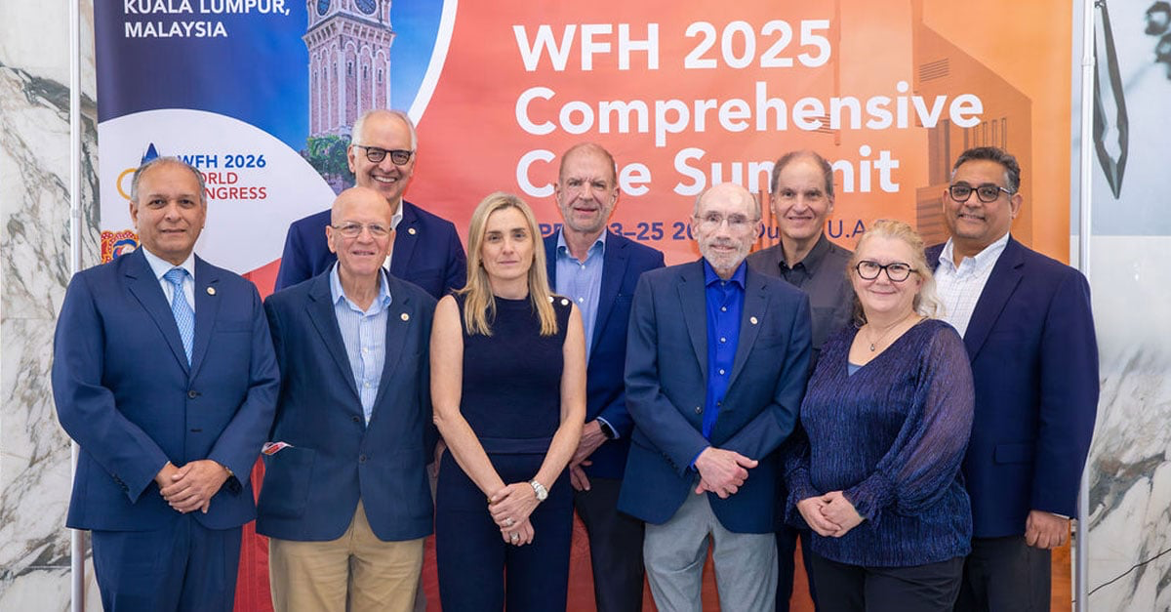
Sanofi’s Mission Statement
“Our mission is two-fold: to support populations in emergencies through a cross‑cutting donation strategy, and to provide rare disease treatment access regardless of geography, background or economic resources.” — Sanofi Foundation S

Slide 3
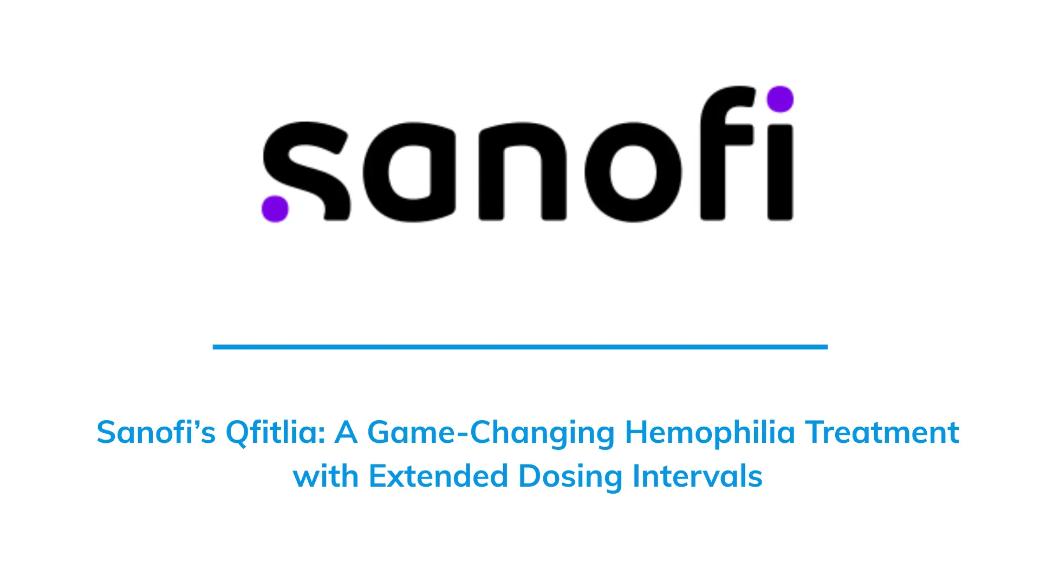

Largest Donation of Hemophilia Factor Therapy in History.
Donate up to 1 billion IUs of factor therapy over a ten-year period to the World Federation of Hemophilia (WFH) Humanitarian Aid Program.
588m IUs of clotting factor donated through 2021**
8,800+ people treated
41 countries
994 children under age 10 receiving prophylaxis treatment
229k+ acute bleeds treated
3,300+ surgeries performed

