Slide 1
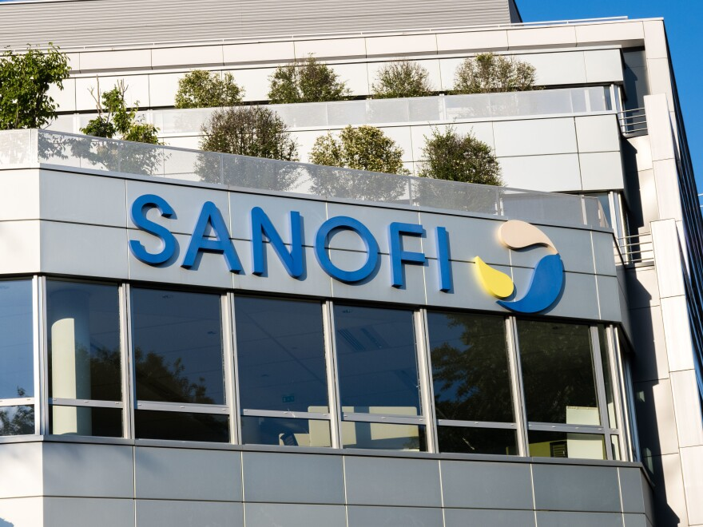
Sanofi Put Simply
By Ben Touhill

Slide 2
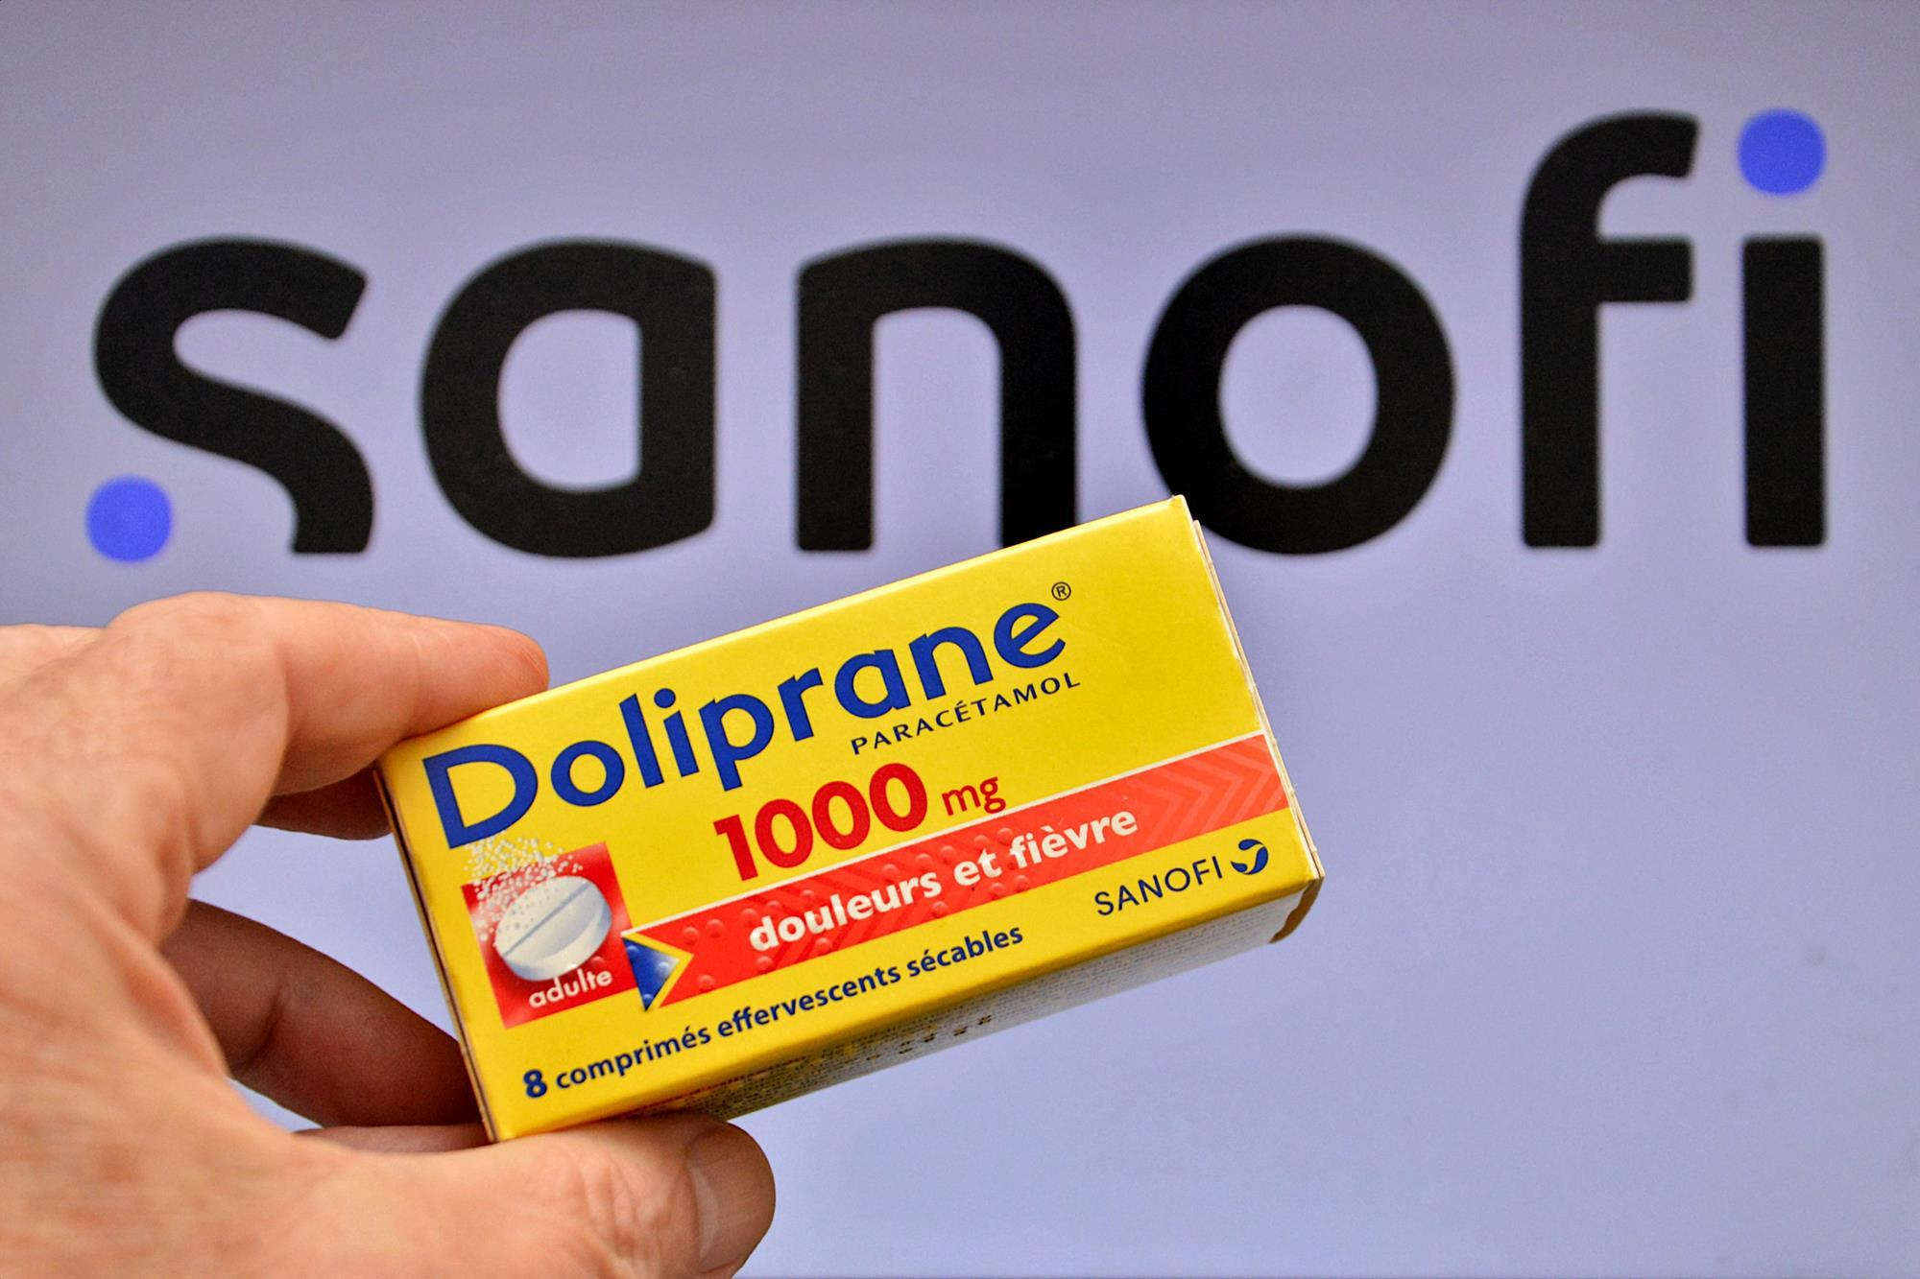
We chase the miracles of science to improve people's lives.
Company Name
Sanofi’s Mission Statement

Slide 3

3 Things Sanofi Has Done in the Past Year
Acquired Dynavax Technologies
Added HEPLISAV-B, an adult hepatitis B vaccine
Also obtained a shingles vaccine and other vaccine candidates.
Expanded the Uses of Dupixent
In 2026, Dupixent got approved at a higher level.
In April 2026, Dupixent became the first medicine was approved in the EU for young children with chronic spontaneous urticaria.
Because of these numbers, it shows how important Sanofi is in the world of medicine.
Financial Gain
In quarter 2 of 2026 Sanofi reported a 17.8% increase in sales
Dupixent Sales increased up to 37.6%
Overall yearly sale increased by 10%

