Slide 1

Getting to Know Sanofi
Danna Cordero

Slide 2


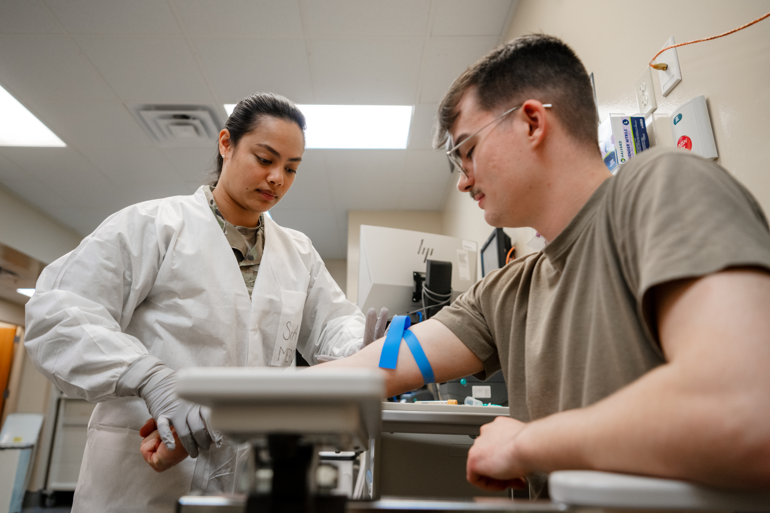
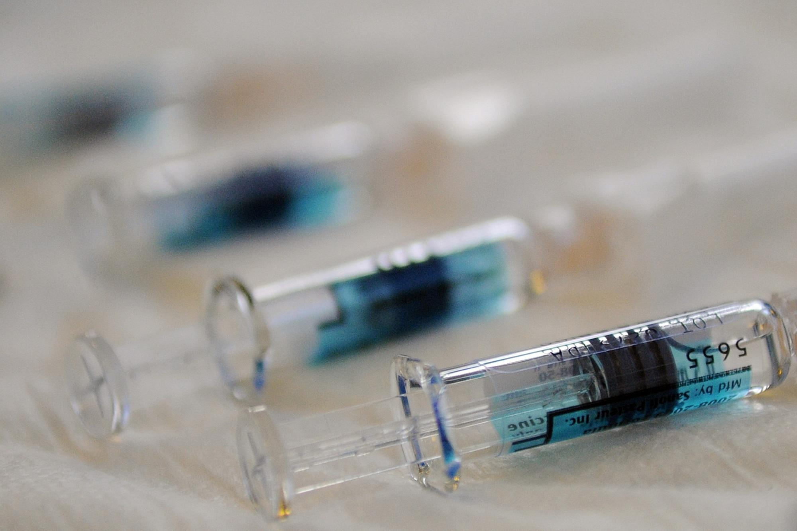
Who Is Sanofi?
SANOFI
A global healthcare & pharmaceutical company
🧬 What they do
-Develop medicines and vaccines
- Research new treatments for different diseases
- Focus on areas like immunology, vaccines, and rare diseases
🌎 Global Impact
- Sanofi works with healthcare professionals and patients around the world.
-Their goal is to use science and innovation to improve people’s health and lives.

Slide 3



What Sanofi Does & Opportunities
SCIENCE → HEALTHCARE → IMPACT
💉 Vaccines
-They create vaccines that help prevent serious diseases and protect communities.
🔬 Research & Development
-Scientists research and test new medicines and treatments to help patients.
💼 Career Opportunities
-Careers include research, clinical studies, manufacturing, healthcare, technology, and business.
* Sanofi also offers internships and early-career opportunities for students

