Slide 1

Sanofi:
A Rare Pharma for Rare Diseases
By: Edward Zuniga

Slide 2
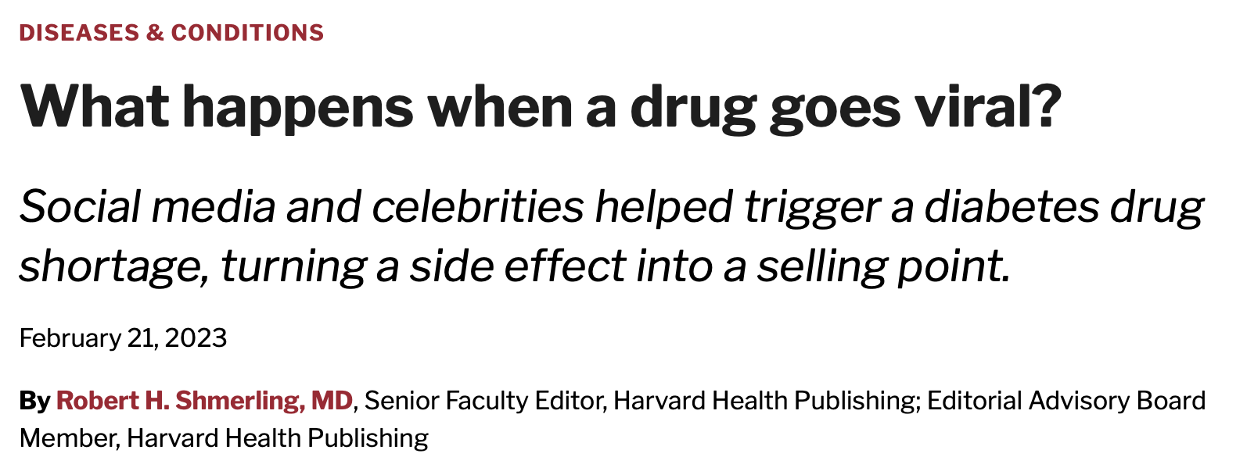


Not a Household Name
When GLP-1 drugs (Exp. Ozempic) went viral in 2023, nearly every major pharma company raced to compete. Eli Lilly and Novo Nordisk built billion-dollar franchises on it. Sanofi didn't join the race.
Most pharma companies compete heavily in the over-the-counter market. Sanofi went the opposite direction, stepping back from OTC products to concentrate entirely on specialized, prescription-driven medicine.
Sanofi stays unfamiliar to the general public on purpose. Their strategy prioritizes rare diseases and specialized treatments over the consumer products that build name recognition.

Slide 3


Learning from Mistakes
During the COVID pandemic, Sanofi attempted to develop its own vaccine in partnership with GSK. Due to delays in development, Sanofi fell behind Pfizer & Moderna and instead shifted to manufacture Moderna's vaccine to support global supply.
Rather than scrapping their research after falling behind, Sanofi used the setback to invest further in science. In 2021, they built an mRNA Center of Excellence to accelerate research on future vaccines.
Sanofi's strategy goes unseen by regular consumers, but the company continues to reinvent itself in service of its philosophy: "we chase the miracles of science to improve people's lives."

