Slide 1
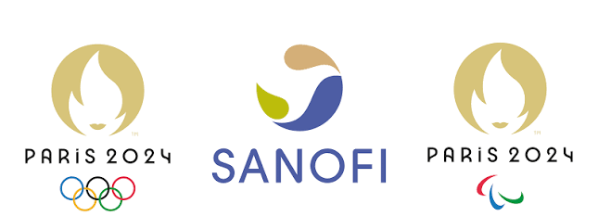
Why Sanofi Inspires Me
By Ethan Carey

Slide 2
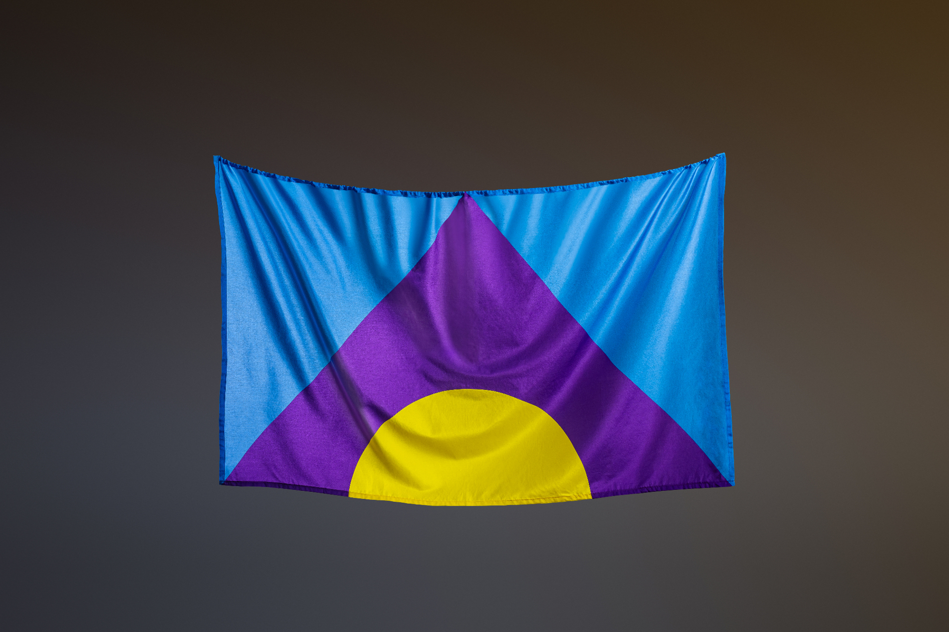
Sanofi and the 2024 Olympics
Sanofi was a partner of the 2024 Paris Olympic and Paralympic Games
The partnership focused on health, science, and human performance
Sanofi used the Olympics to promote awareness about health and disease prevention
They also supported the Meningitis Flag to raise awareness about meningitis

Slide 3

Why Sanofi Inspires Me
Sports and health
As an athlete, I understand how important health is for performance and recovery.
Science and the human body
Sanofi uses science to better understand diseases and develop new treatments. As someone who plans to pursue a career in healthcare, I find this especially inspiring because I want to help improve people's health and quality of life.
Teamwork
Sanofi brings together scientists, athletes, patients, and communities who all work together to make the world a better place.
Global impact
The Olympics gave Sanofi an opportunity to reach new people from around the world!

