Slide 1
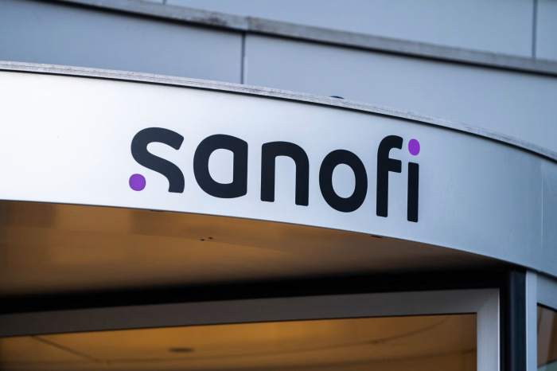
Chasing the Miracles of Science to Improve People’s Lives
Corporate Mentor Program | 2026
BY Fiorella Piedra-Rodriguez

Slide 2
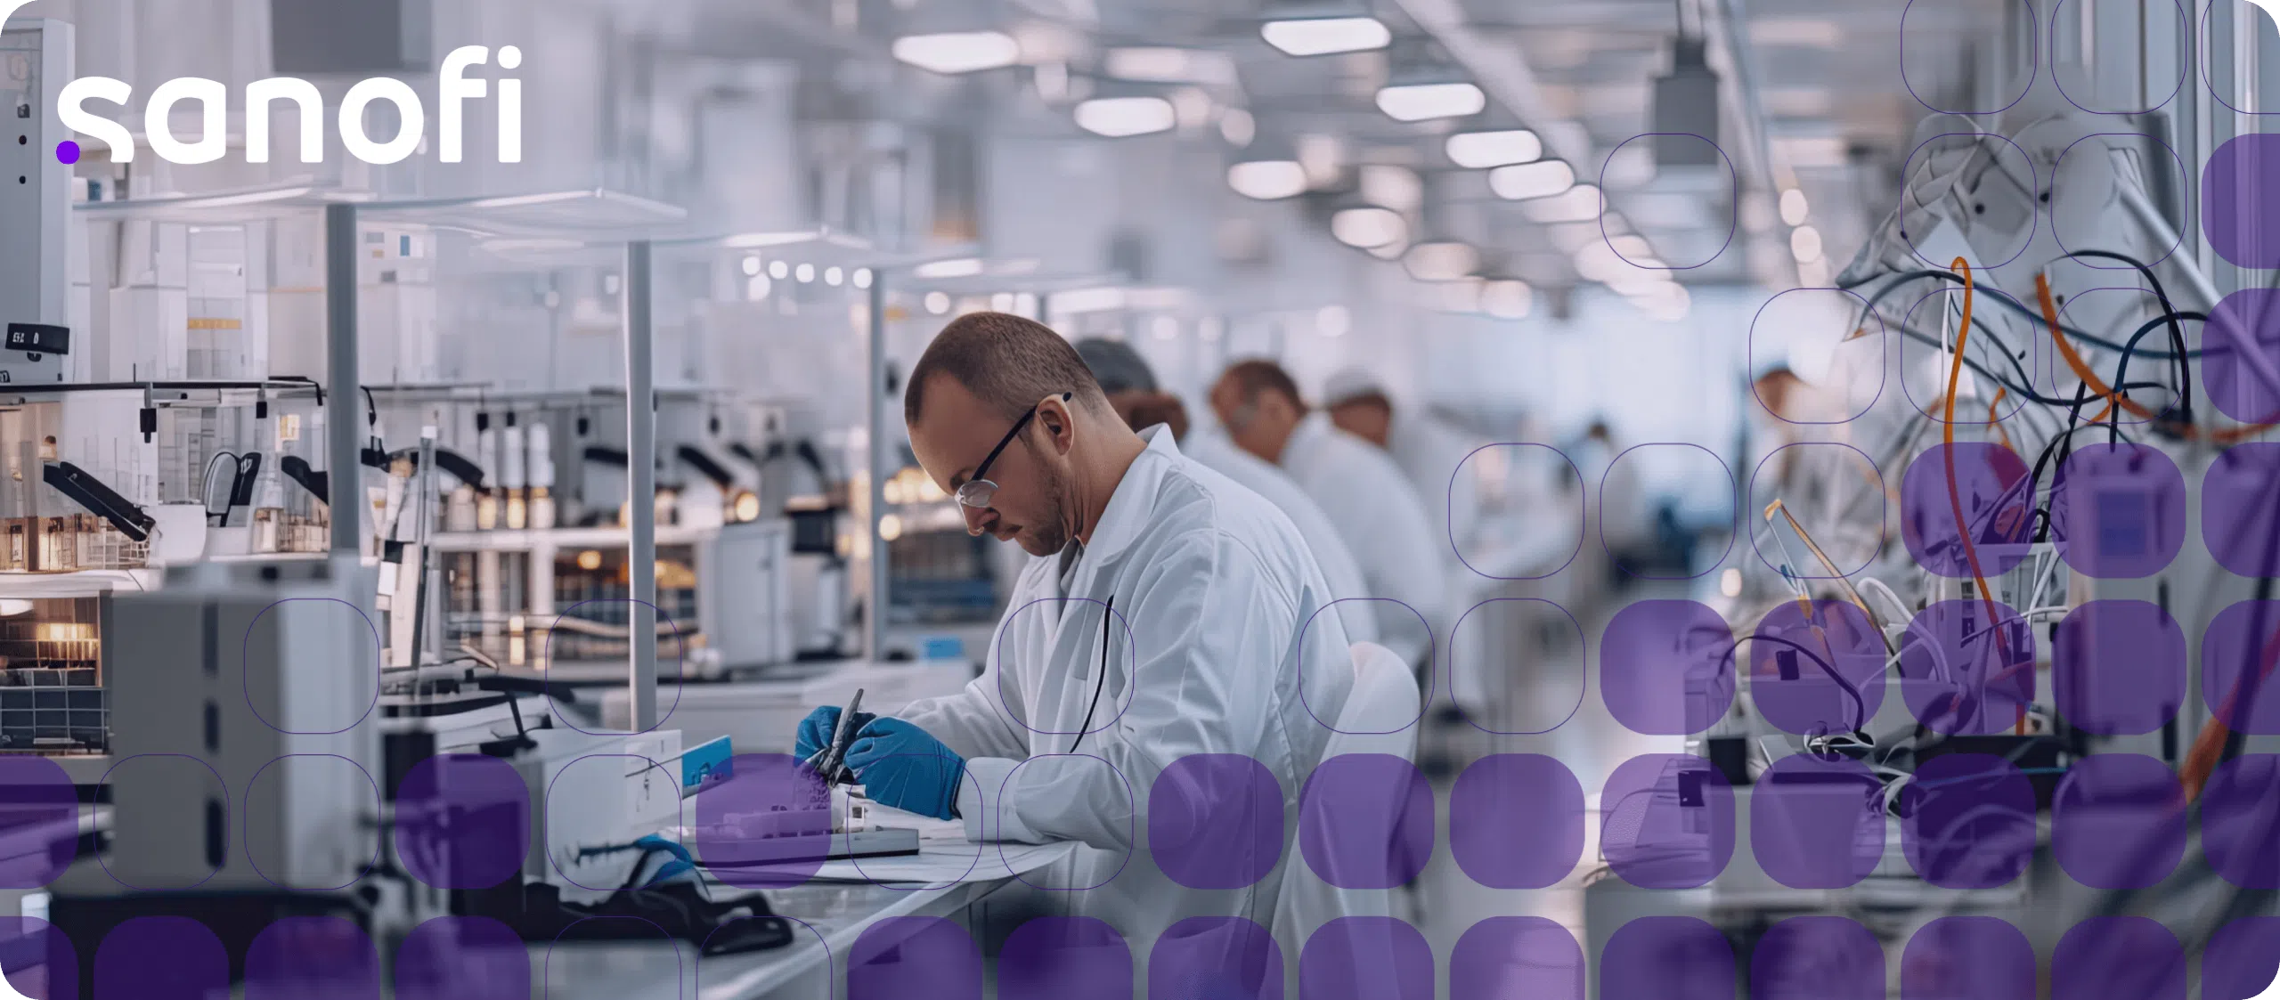


WHO IS
?
Global Biopharmaceutical Company
  Headquartered in Paris, France
  74,400+ Employees
  Present in 60+ countries
What do they do?
  Research and develop innovative medicines and vaccines
  Key areas of development: immunology, rare diseases, neurology, oncology, etc...
Impact at a glance
  500M+ people vaccinated each year
  2.5M vaccine doses supplied daily
  77 compounds in clinical development

Slide 3
BEYOND MEDICINE
Improving lives through science & investing in the people behind the future.
DISASTER RELIEF PROGRAMS
SUMMER CAMP AID
  Americares
  Direct Relief
  Heart to Heart
  +map
  Project HOPE
  Supports summer camps for children living with serious health conditions
  Has supported Diabetes camps for +20 years
  Approx. 100 diabetes camps supported
  $2 MILLION+
Value of insulin donated
  20,000+ young children served

Slide 4

THANK YOU
FOR YOUR
ATTENTION
ANY QUESTIONS?

Slide 5
Sources:
https://www.sanofi.us/en/our-company
https://www.sanofifoundation-northamerica.org/programs

