Slide 1

Sanofi at a Glance
Owen Pierro

Slide 2
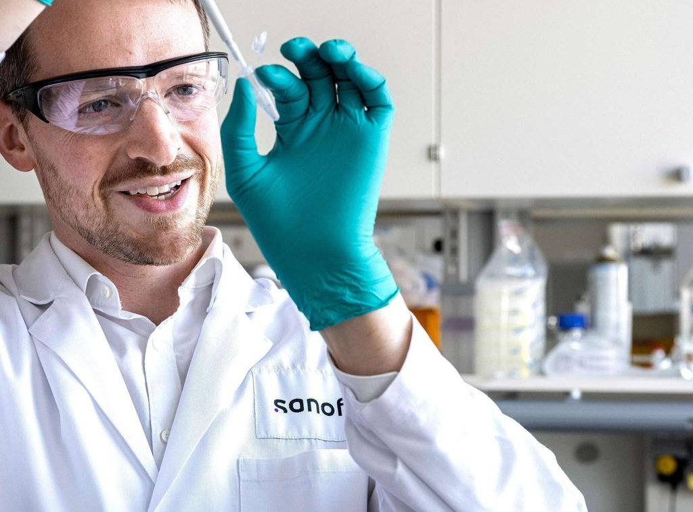
Who is Sanofi?
Global leader in biopharmaceutical innovation
Develops medicines and vaccines for complex diseases
R & D Focus areas: Immunology, vaccines, neurology, oncology, rare diseases
Leader in immuno-science and biologic therapies
Uses artificial intelligence to advance research and manufacturing
Research → Clinical Trials → Manufacturing → Patient Care

Slide 3
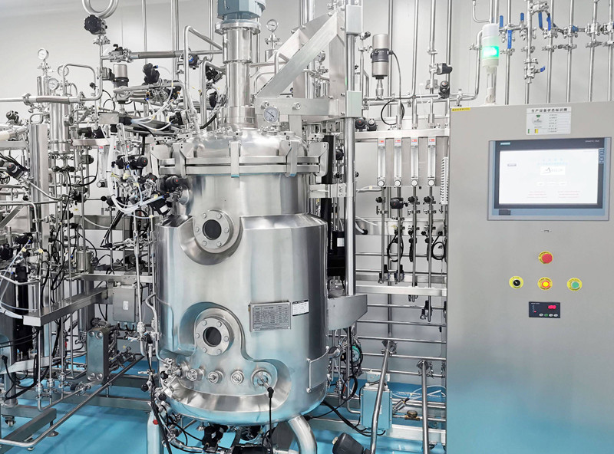
What Makes Sanofi Unique?
Many medicines are grown using living cells
Cells are engineered to produce therapeutic proteins
Proteins are grown in large bioreactors
Medicines undergo extensive purification and quality testing
Every batch is tested before reaching patients

