Slide 1
Sanofi: Oil Built a Drug
France, 1973
By Samia Bouzid
August, 2026
Notes:
SLIDE 1 (about 25 seconds)
Good morning. Something I didn't know before this: Sanofi was started by an oil company. In 1973 a French oil company called Elf Aquitaine wanted to diversify, so it bought a pharmaceutical business and named it Sanofi.
It grew by merging with other companies, first Synthélabo in 1999 and then Aventis in 2004, which is when it became the company we'd recognize today.
The global headquarters is in Paris and the U.S. headquarters is in Morristown, New Jersey, which isn't far from here. It's now one of the ten biggest drug companies in the world.

Slide 2
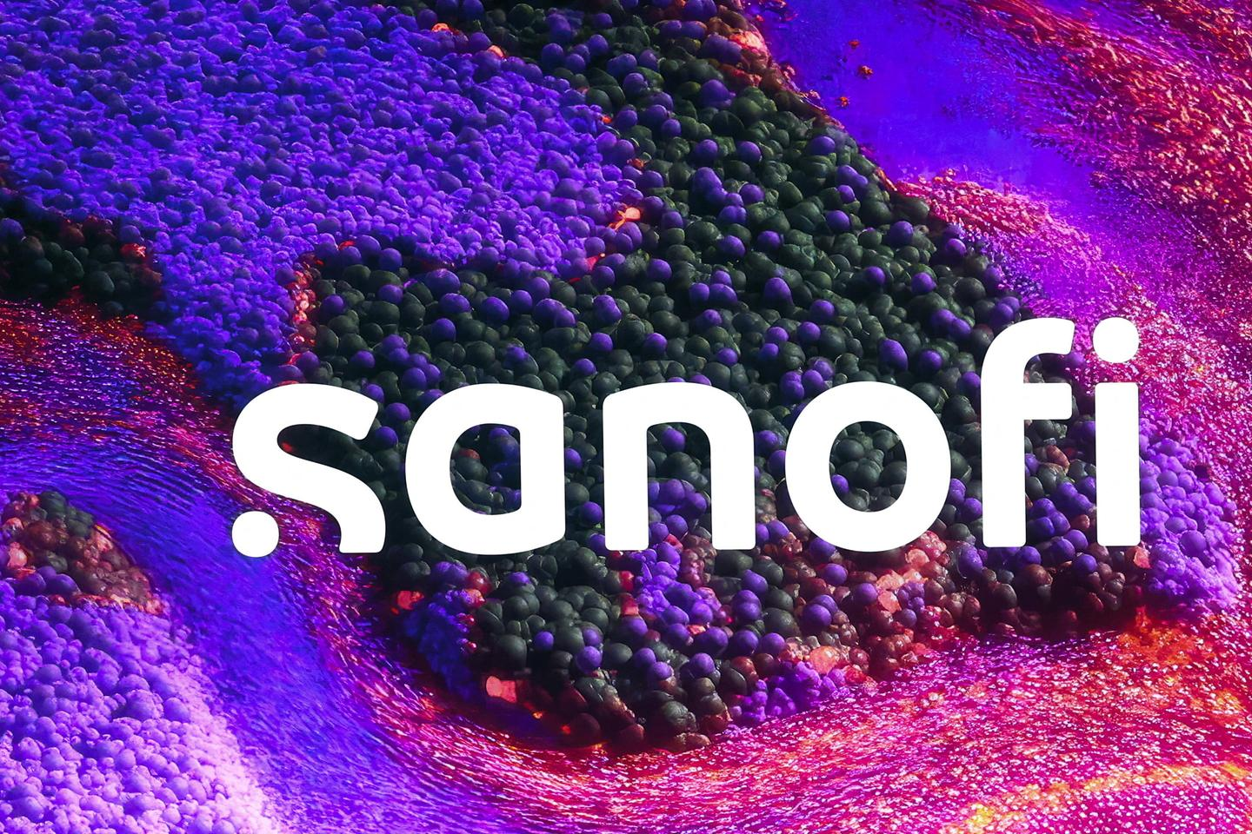
What Sanofi Does?
Medicines and Vaccines
Their Biggest Product
Sanofi is a pharmaceutical company. They make prescription medicines and vaccines, mainly for immune diseases and rare diseases, and to prevent infections.
Dupixent treats eczema, asthma and COPD(lung disease) . It brings in about a third of everything Sanofi sells.
Their Patients and Doctors
The Two Biggest Problems
Most patients have a long term condition such as eczema, asthma or diabetes, or a rare genetic disease. Their medicines are prescribed by dermatologists, pediatricians and neurologists.
Getting diagnosed sooner, and being able to afford treatment. A rare disease can take years to identify, and once you start these medicines you are usually on them for life.
Notes:
SLIDE 2 (about 50 seconds)
Sanofi makes prescription medicines and vaccines. They work in three areas: Specialty Care, which is the biggest, then Vaccines, then General Medicines.
The product to know is Dupixent. It treats eczema, asthma and COPD, and on its own it brings in about a third of the company's sales.
On the vaccine side they make flu shots, the standard childhood vaccines, and Beyfortus, which protects babies from RSV. General Medicines is mostly insulin, like Lantus and Toujeo.
Their patients usually have something long term. Eczema, asthma, diabetes, or a rare genetic disease. The doctors who prescribe all this are mainly dermatologists, pediatricians and neurologists.
Now, the two biggest problems those patients have. The first is getting diagnosed. With a rare disease it can take years before anyone figures out what you actually have, and you're not being treated that whole time. The second is cost. These medicines are expensive and you're usually on them for the rest of your life. So a better drug isn't the only thing that helps. Diagnosing people faster and making it affordable matter just as much.

Slide 3

What Sanofi Has Been Doing in 2026?
A New CEO
Growing Faster Than Expected
Belén Garijo became chief executive in May 2026, taking over from Paul Hudson after six years.
After a strong second quarter, Sanofi raised its forecast in July and now expects to grow about 10% this year.
Investing in U.S. Manufacturing
Career Opportunities
Sanofi is spending at least $20 billion in the United States through 2030, including upgrades to its plants in Pennsylvania and Massachusetts.
Sources: Sanofi press releases and financial results,2025-2026;Sanofi.com
Sanofi hires in research and development, commercial, quality, and manufacturing and supply. They also run internships and rotational programs for students and recent graduates.
Notes:
SLIDE 3 (about 50 seconds)
A few things from this year. Sanofi has a new CEO, Belén Garijo, who started in May, taking over from Paul Hudson. They had a strong second quarter and raised their forecast in July, so they now expect about 10% growth. And they're putting at least twenty billion dollars into US manufacturing through 2030, including their plants in Pennsylvania and Massachusetts.
As for working there, you can go into research and development, commercial, quality, or manufacturing and supply. They also run internships and rotational programs for students.
I'm a business major, so the business side is where I'd fit. And that's actually why the way this company started stuck with me. It wasn't scientists with a mission, it was a business decision. A lot of what made Sanofi big came from decisions like that rather than from discoveries in a lab.
That's what I want to ask people about at the networking session.
Thank you.

